Slide 1
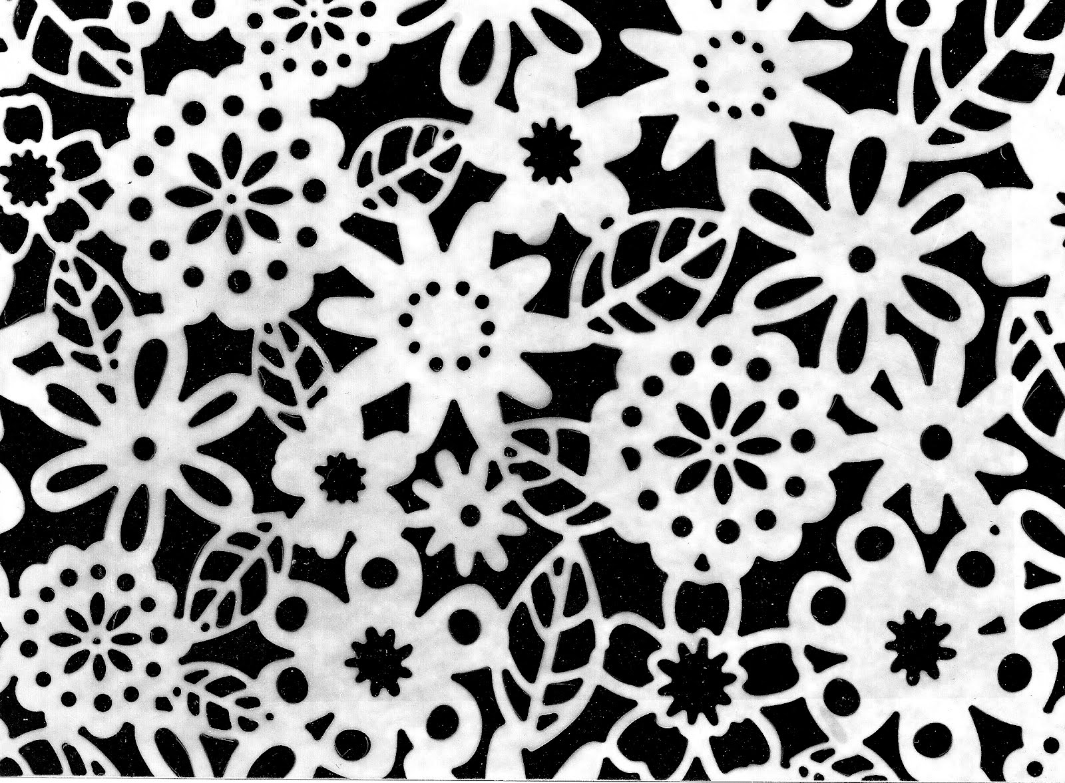
The Photogram

Slide 2
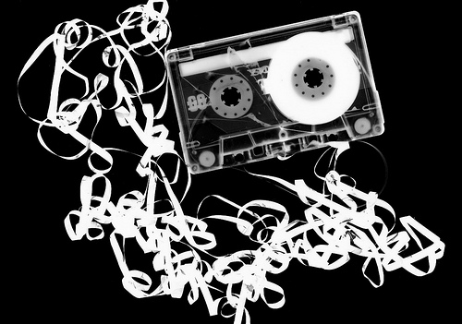
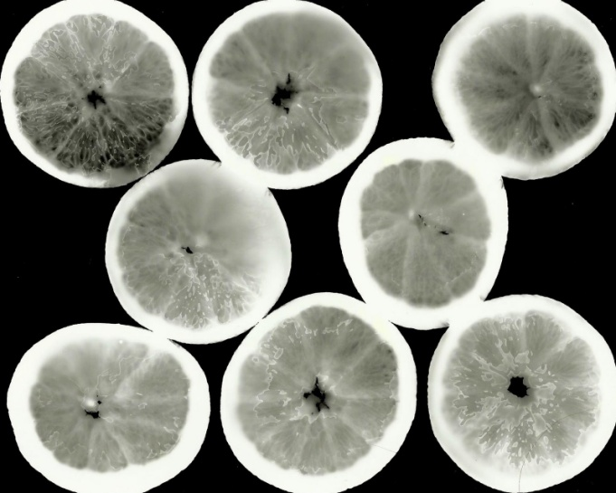
What is a photogram?
A photogram is a photographic image made without a camera by placing objects directly onto the surface of a light-sensitive material such as photographic paper and then exposing it to light.
The usual result is a negative shadow image that shows variations in tone that depends upon the transparency of the objects used.
Areas of the paper that have received no light appear white; those exposed through transparent or semi-transparent objects appear grey.

Slide 3
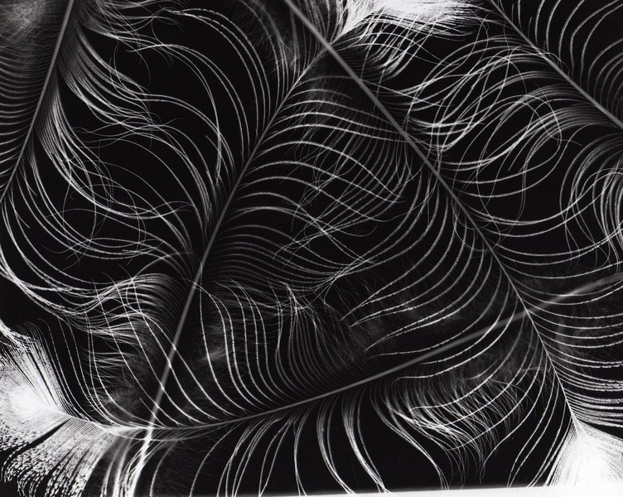
Famous Photogram Artists

Slide 4
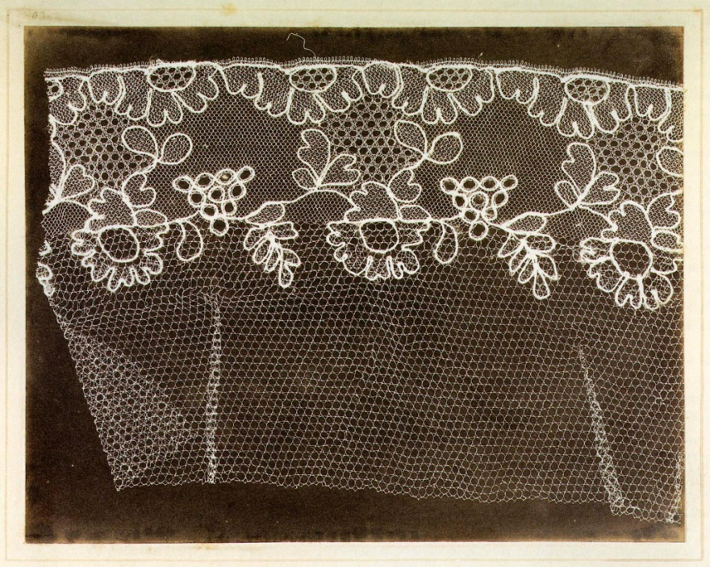
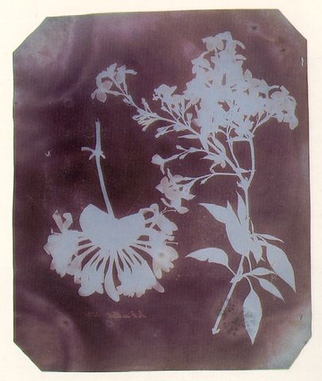
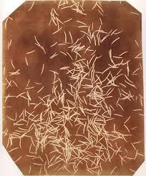
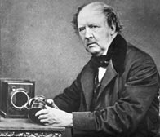
William Henry Fox Talbot

Slide 5
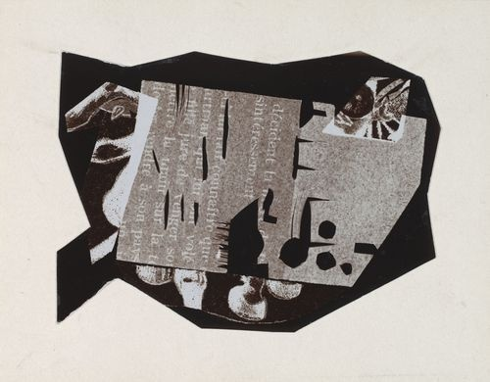
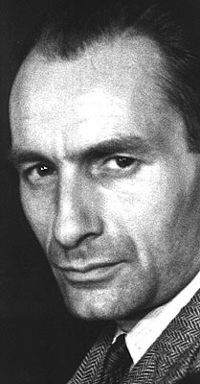
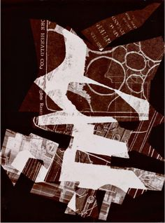
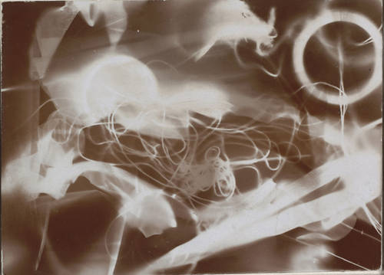
Christian Schad
Schad's imagery was constructed by taking discarded unimportant objects and arranging them. He called them “Schadographs.”

Slide 6
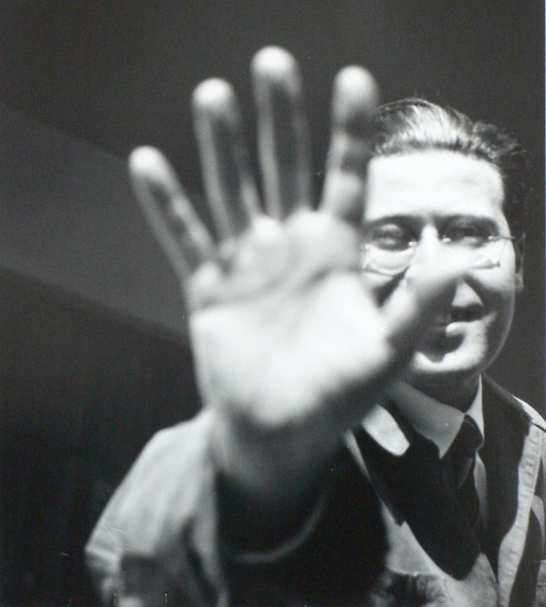
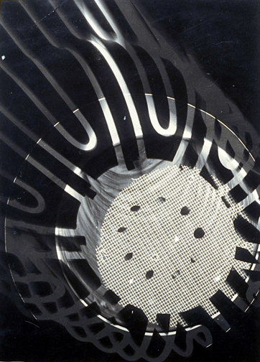
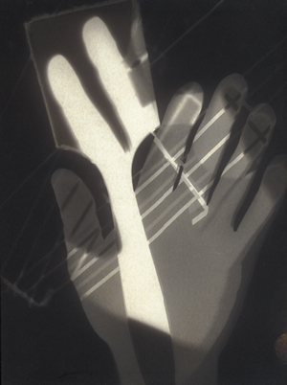
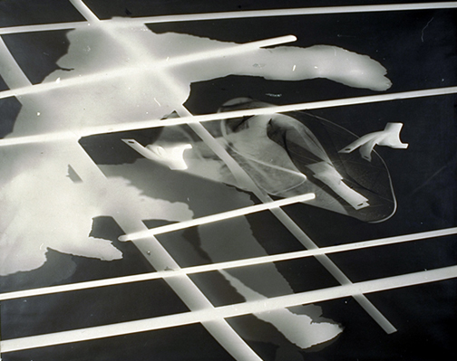
László Moholy-Nagy
Moholy-Nagy has the largest collection of photograms on record. There are 430 pieces in his collection.

Slide 7
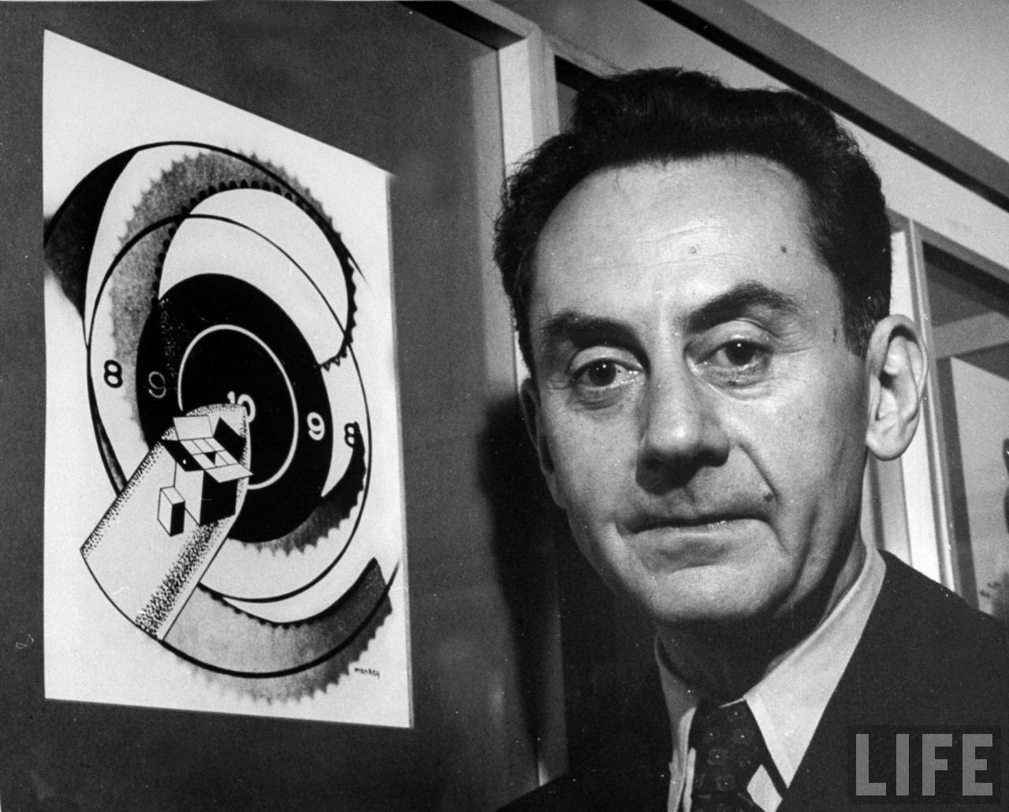
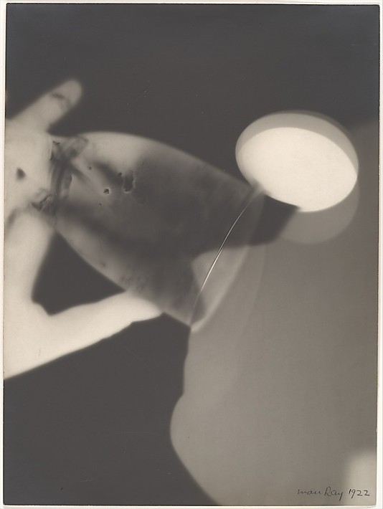
Man Ray
Man Ray called his photograms “Rayographs”

Slide 8
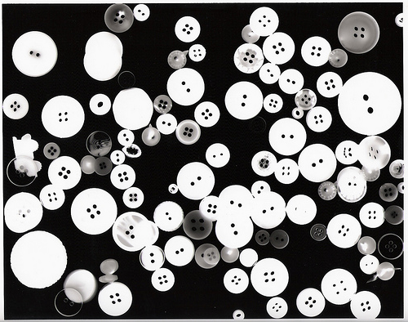
The Process

Slide 9
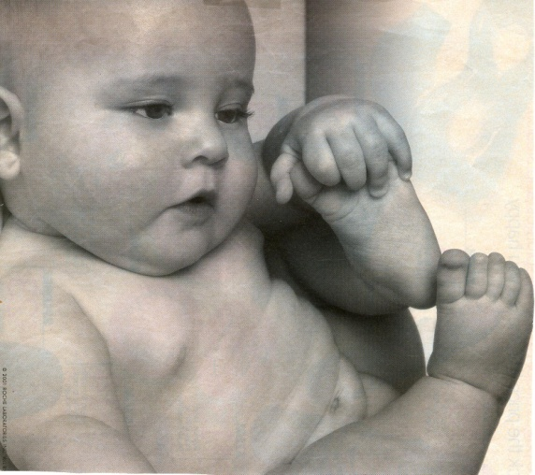
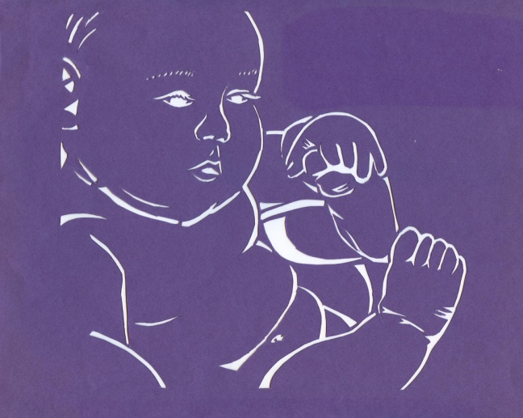
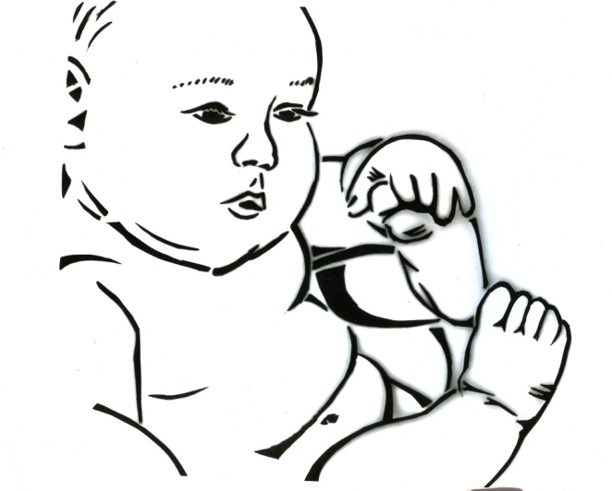
The Process:
1. Choose an image
2. Draw your image and create a stencil
3. Use your stencil to print your photogram in the darkroom

Slide 10
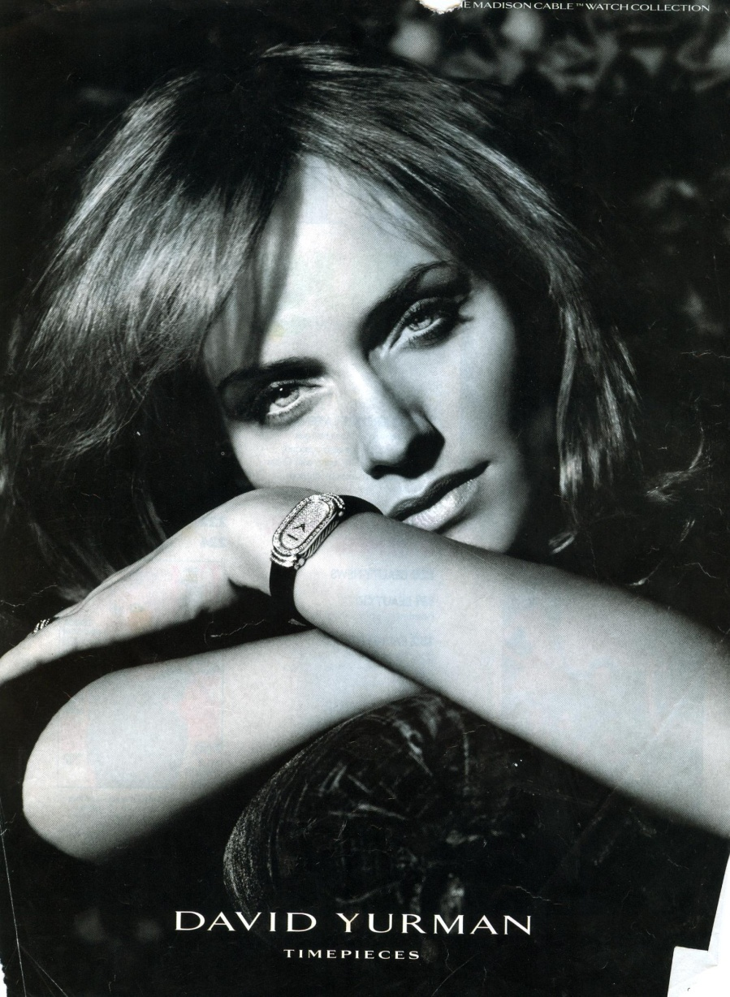
Step 1 - Choose an image
The image you select should be an image of a person.
You could choose:
A picture of you or a friend
A picture of a famous person
A human cartoon character
A random person from a magazine
It will work best if you choose a head and shoulders shot of your person.

Slide 11
Step 2 – Draw your image and create a stencil
You will start by tracing the photogram stencil onto your newsprint. This will determine the size of your photogram.
Next you will need to draw your image on your newsprint. You can do this using a grid, you could use a light table and trace, or you can draw it freehand.
After you draw your image and have it on newsprint you will transfer your image to construction paper. You will do this by coloring the back of your newsprint image, next place it on top of your construction paper, then trace over the lines of your image.

Slide 12
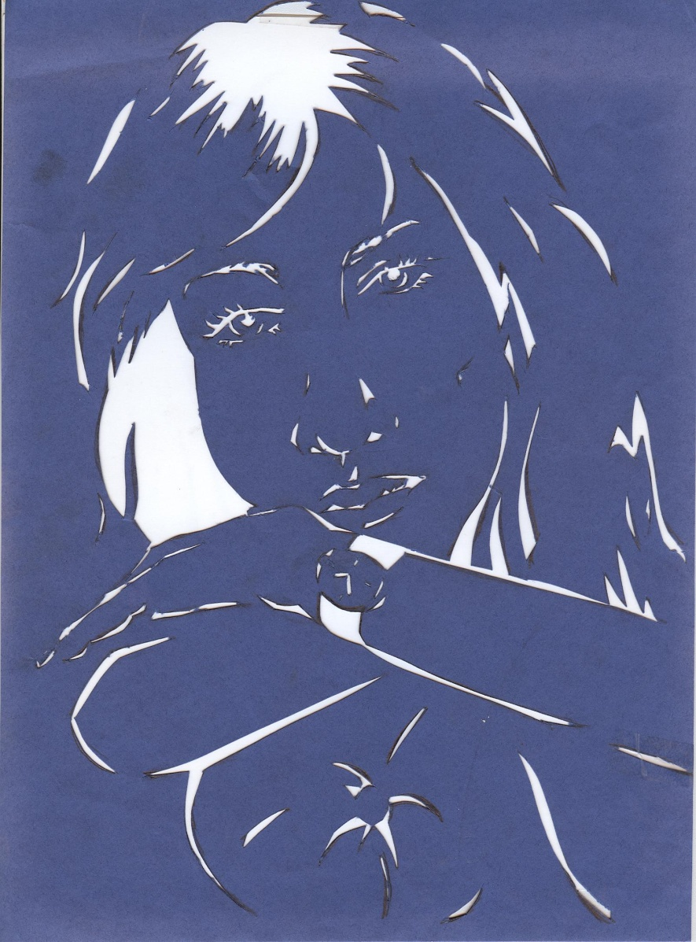
Step 2 – Draw your image and create a stencil
After you have your image transferred to construction paper, you will use black sharpie to color in all of the areas that you want to be black in your final image.
Now you will use an x-acto knife to cut out all the areas that you colored black. Be sure to have a piece of scrap mat board under your paper so you don’t cut the table

Slide 13
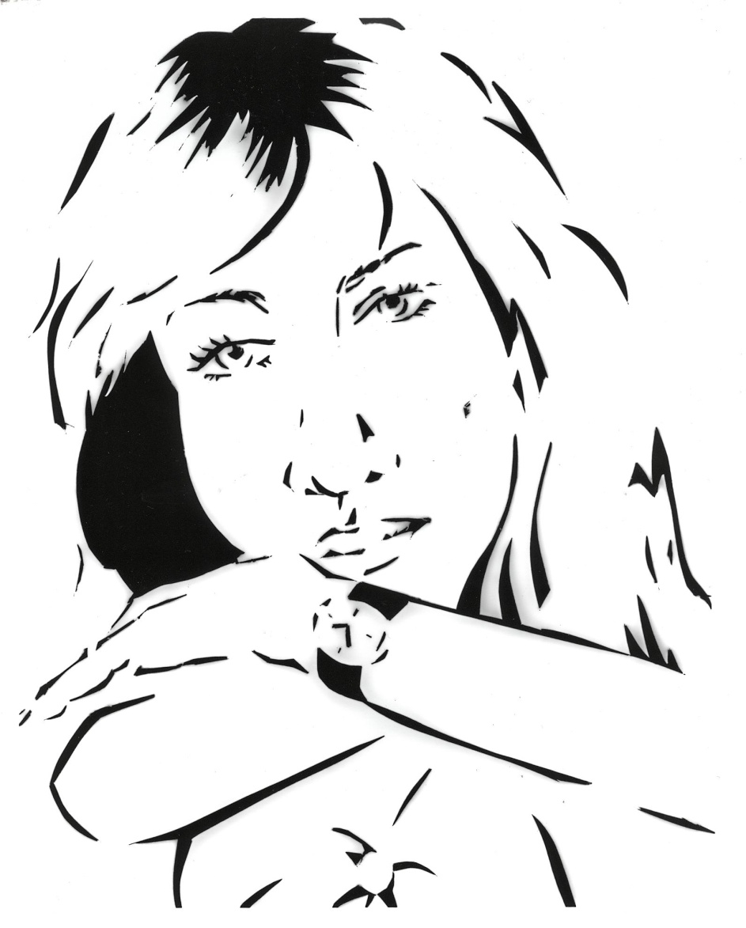
Step 3 – Print your stencil in the darkroom
Now comes the fun part! You will use your stencil to make a print in the darkroom.
In the darkroom:
Turn on your enlarger
Raise the enlarger all the way up
Turn the aperture to the brightest setting
Place your stencil on the enlarger work space, making sure that light touches all parts of the stencil
Turn your timer to 3 seconds, and then turn your timer to OFF
Take out one piece of photo paper
Gently slide the photo paper (shiny side up) under the stencil, being sure NOT to move the stencil.
Place a piece of glass over the paper and stencil
Turn your timer to TIME, and hit the white print button
Take your paper to the chemicals and…
You’re done!

Slide 14
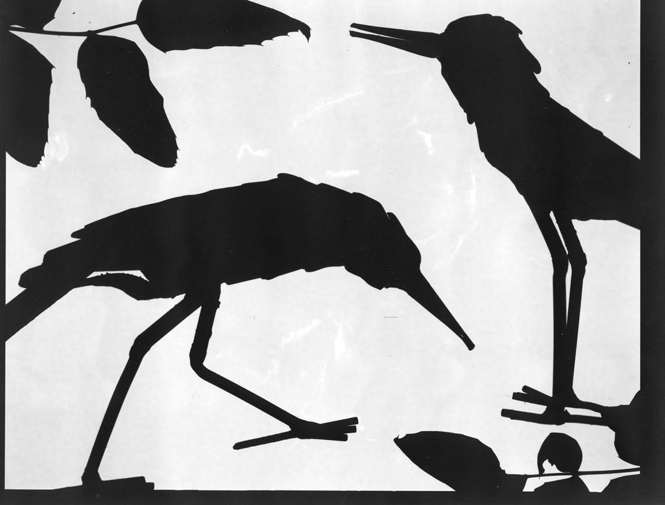
Student Examples

Slide 15
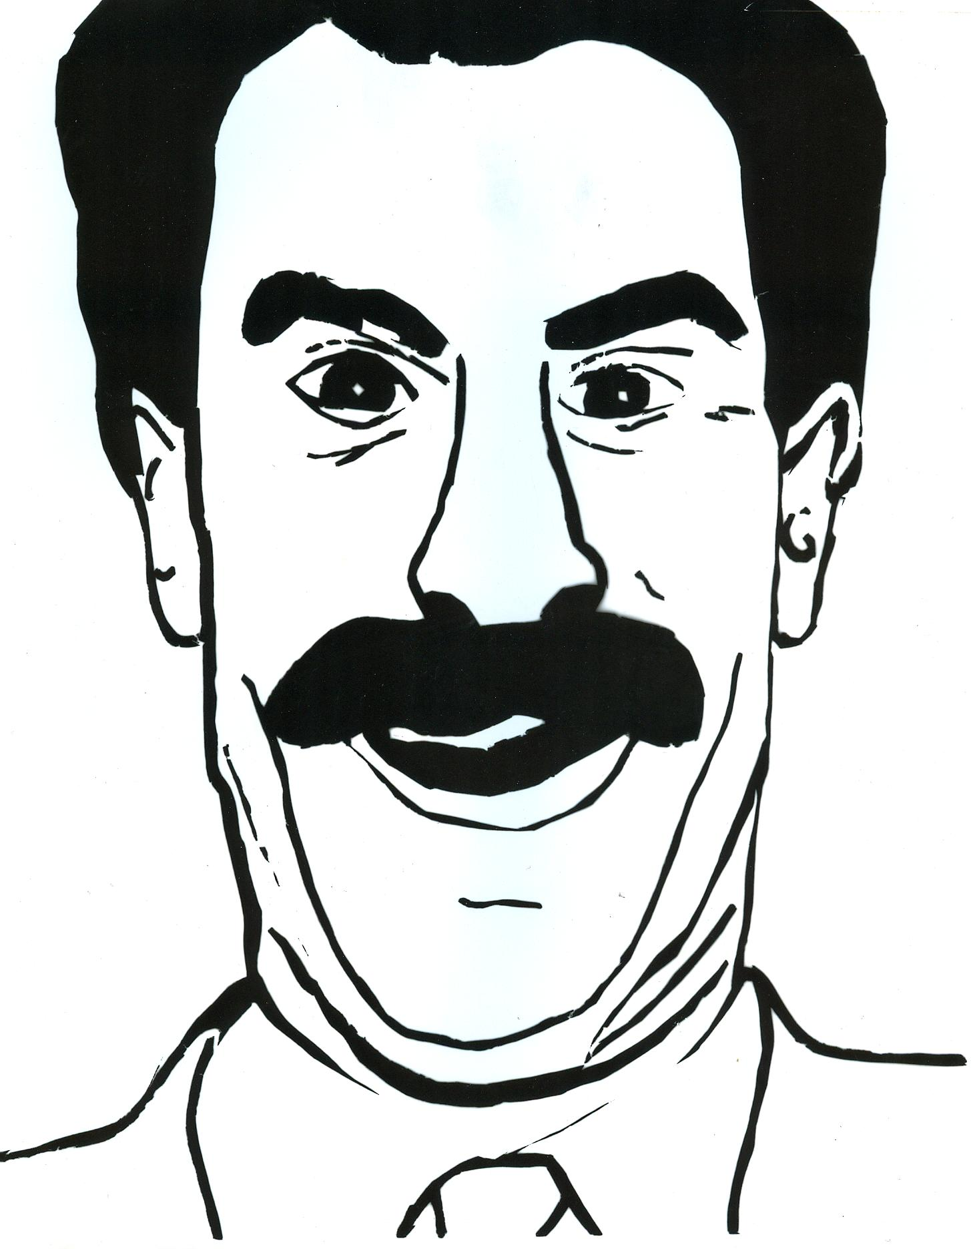

Slide 20
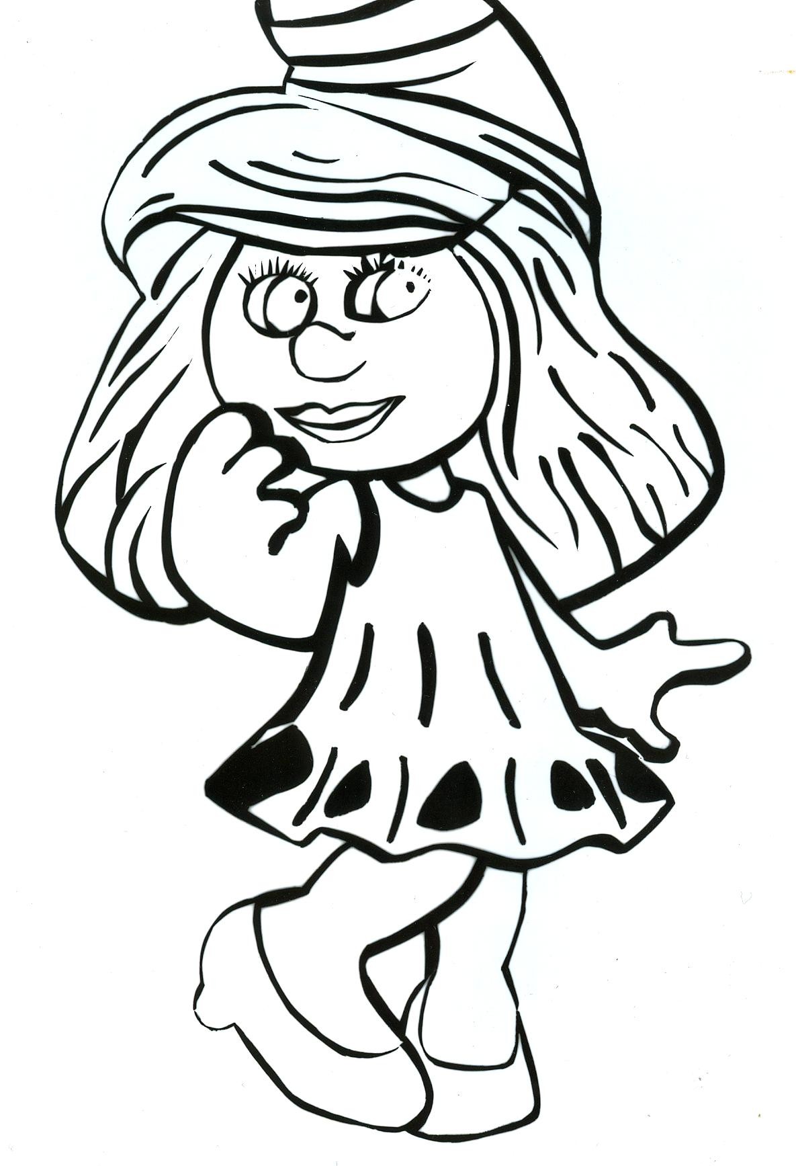

Slide 21
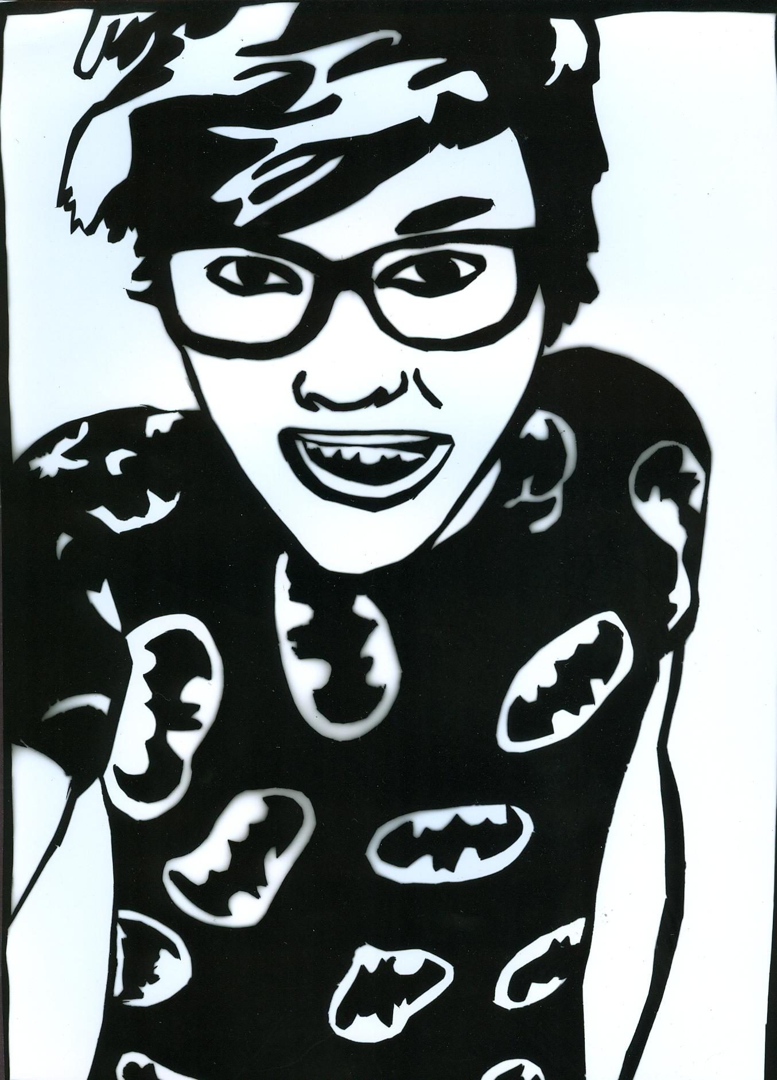

Slide 22
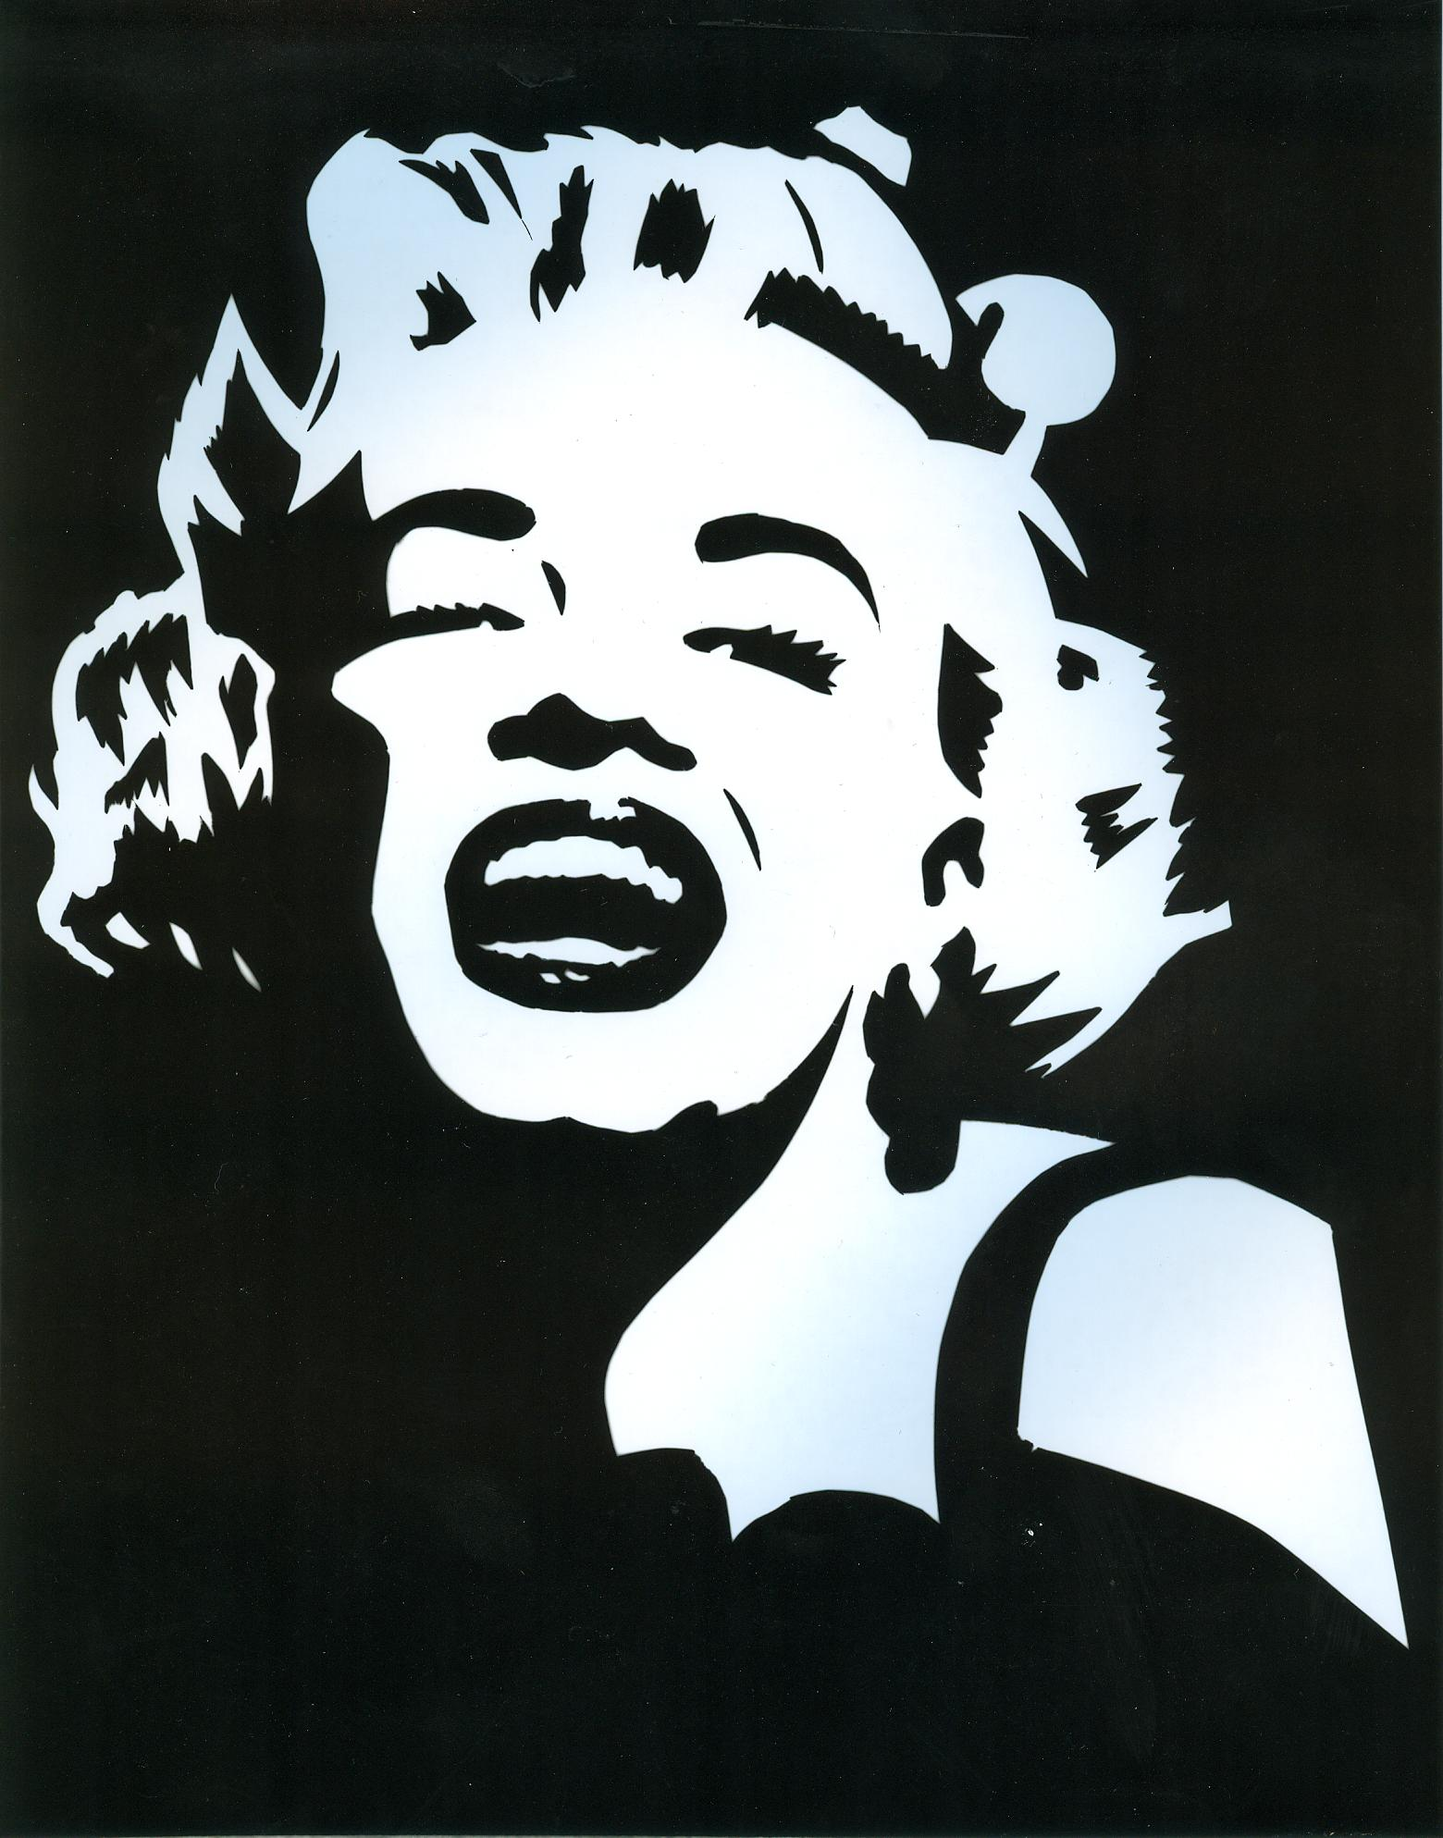

Slide 23
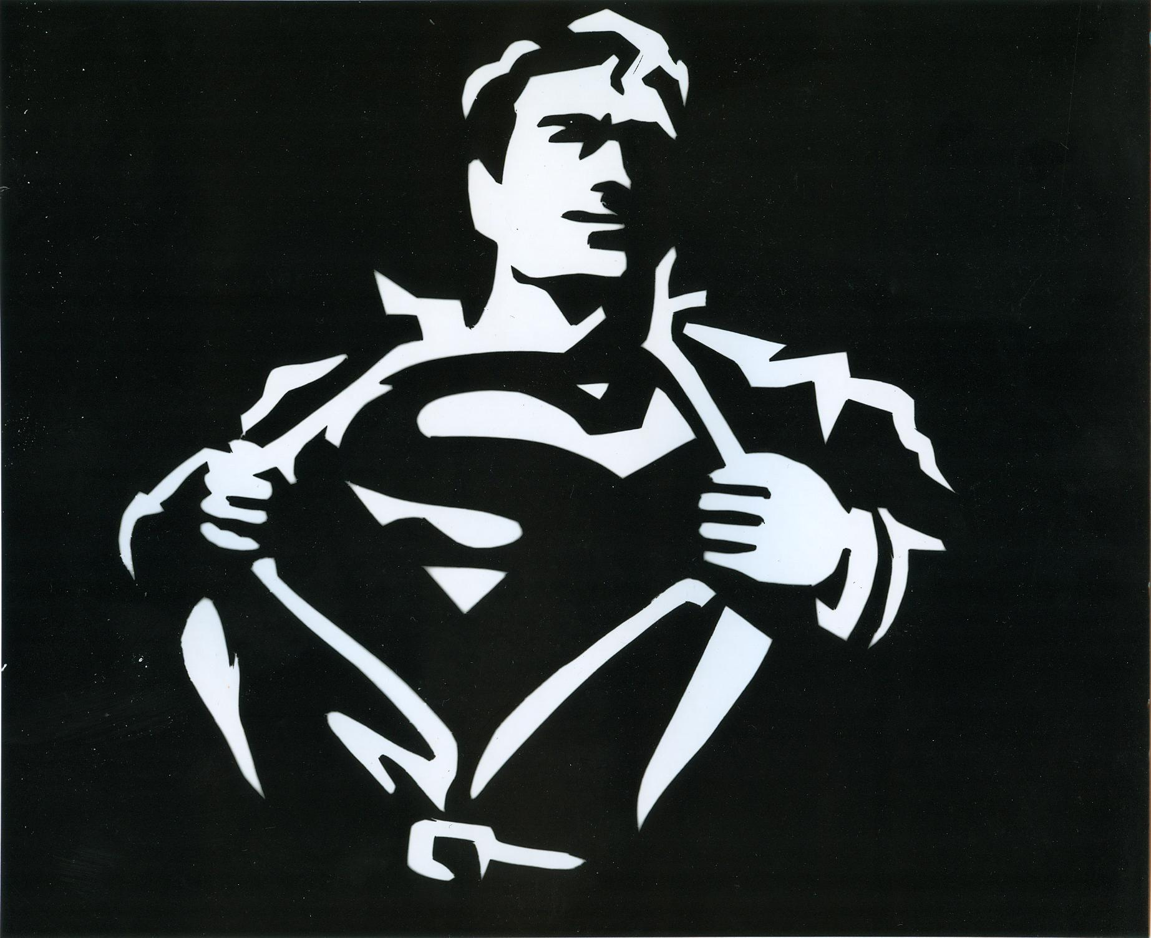

Slide 24
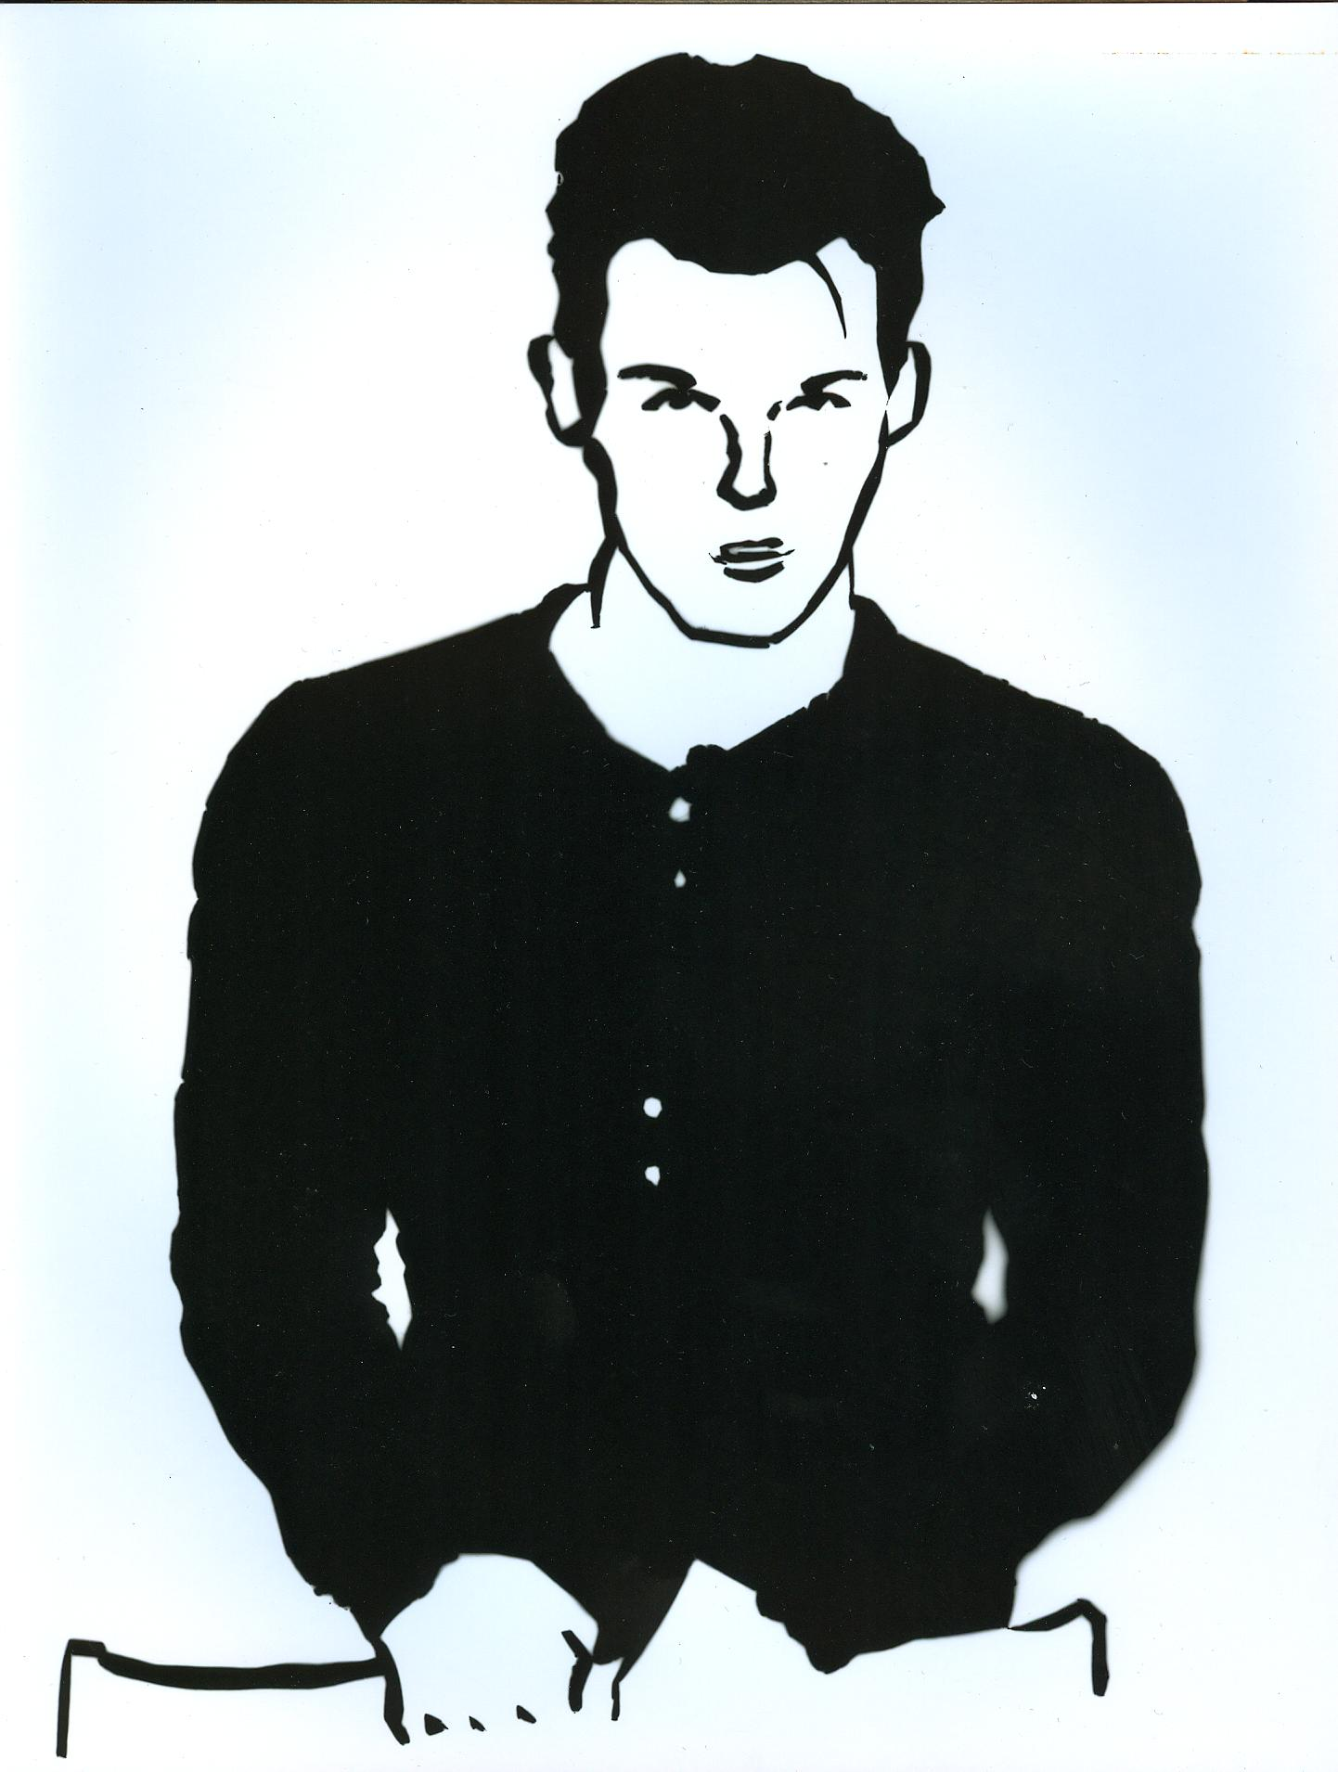

Slide 25
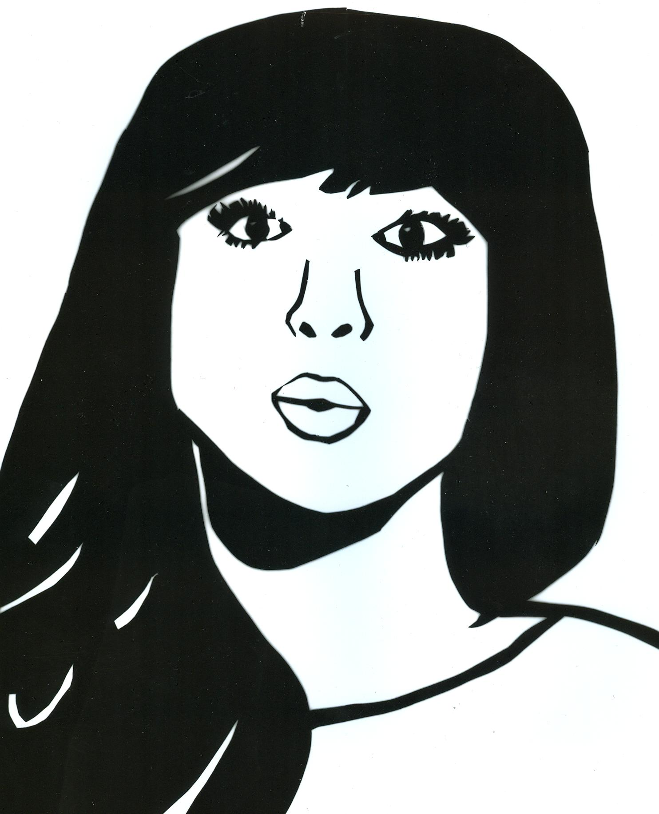

Slide 26
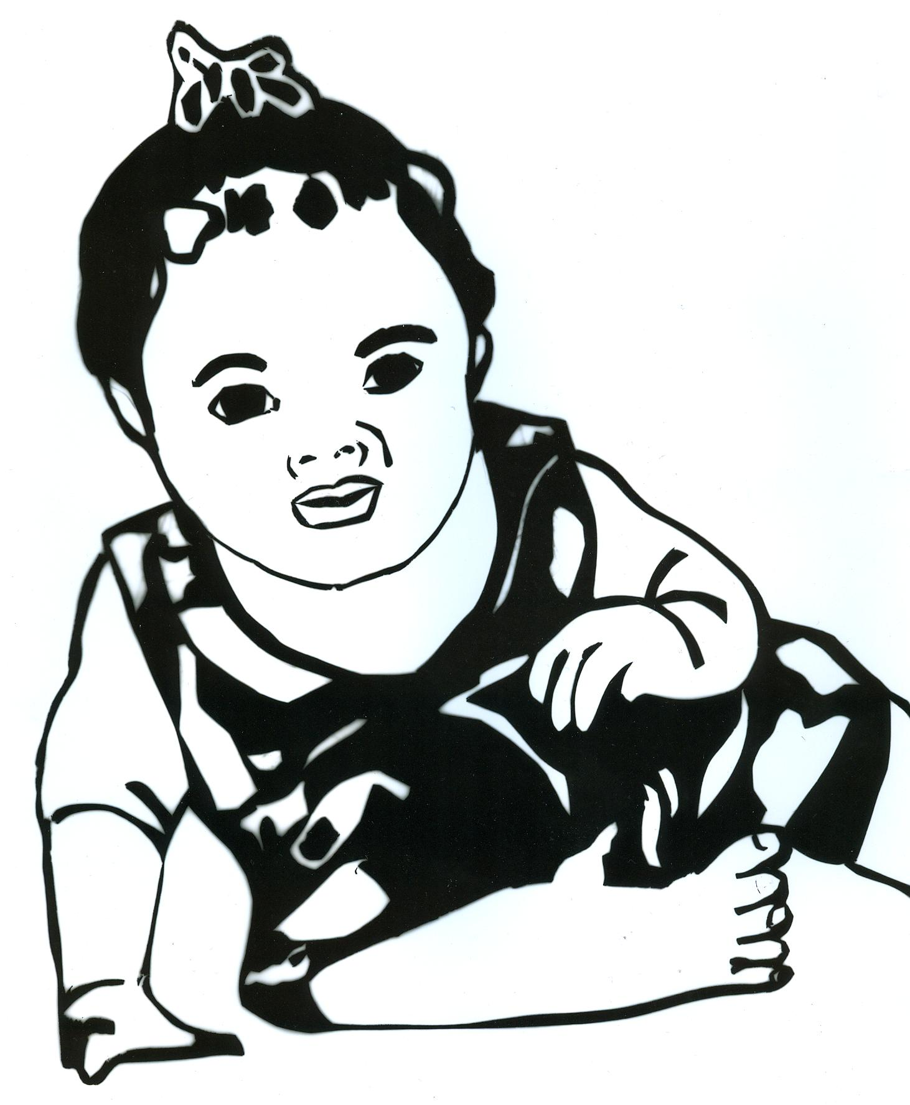

Slide 27
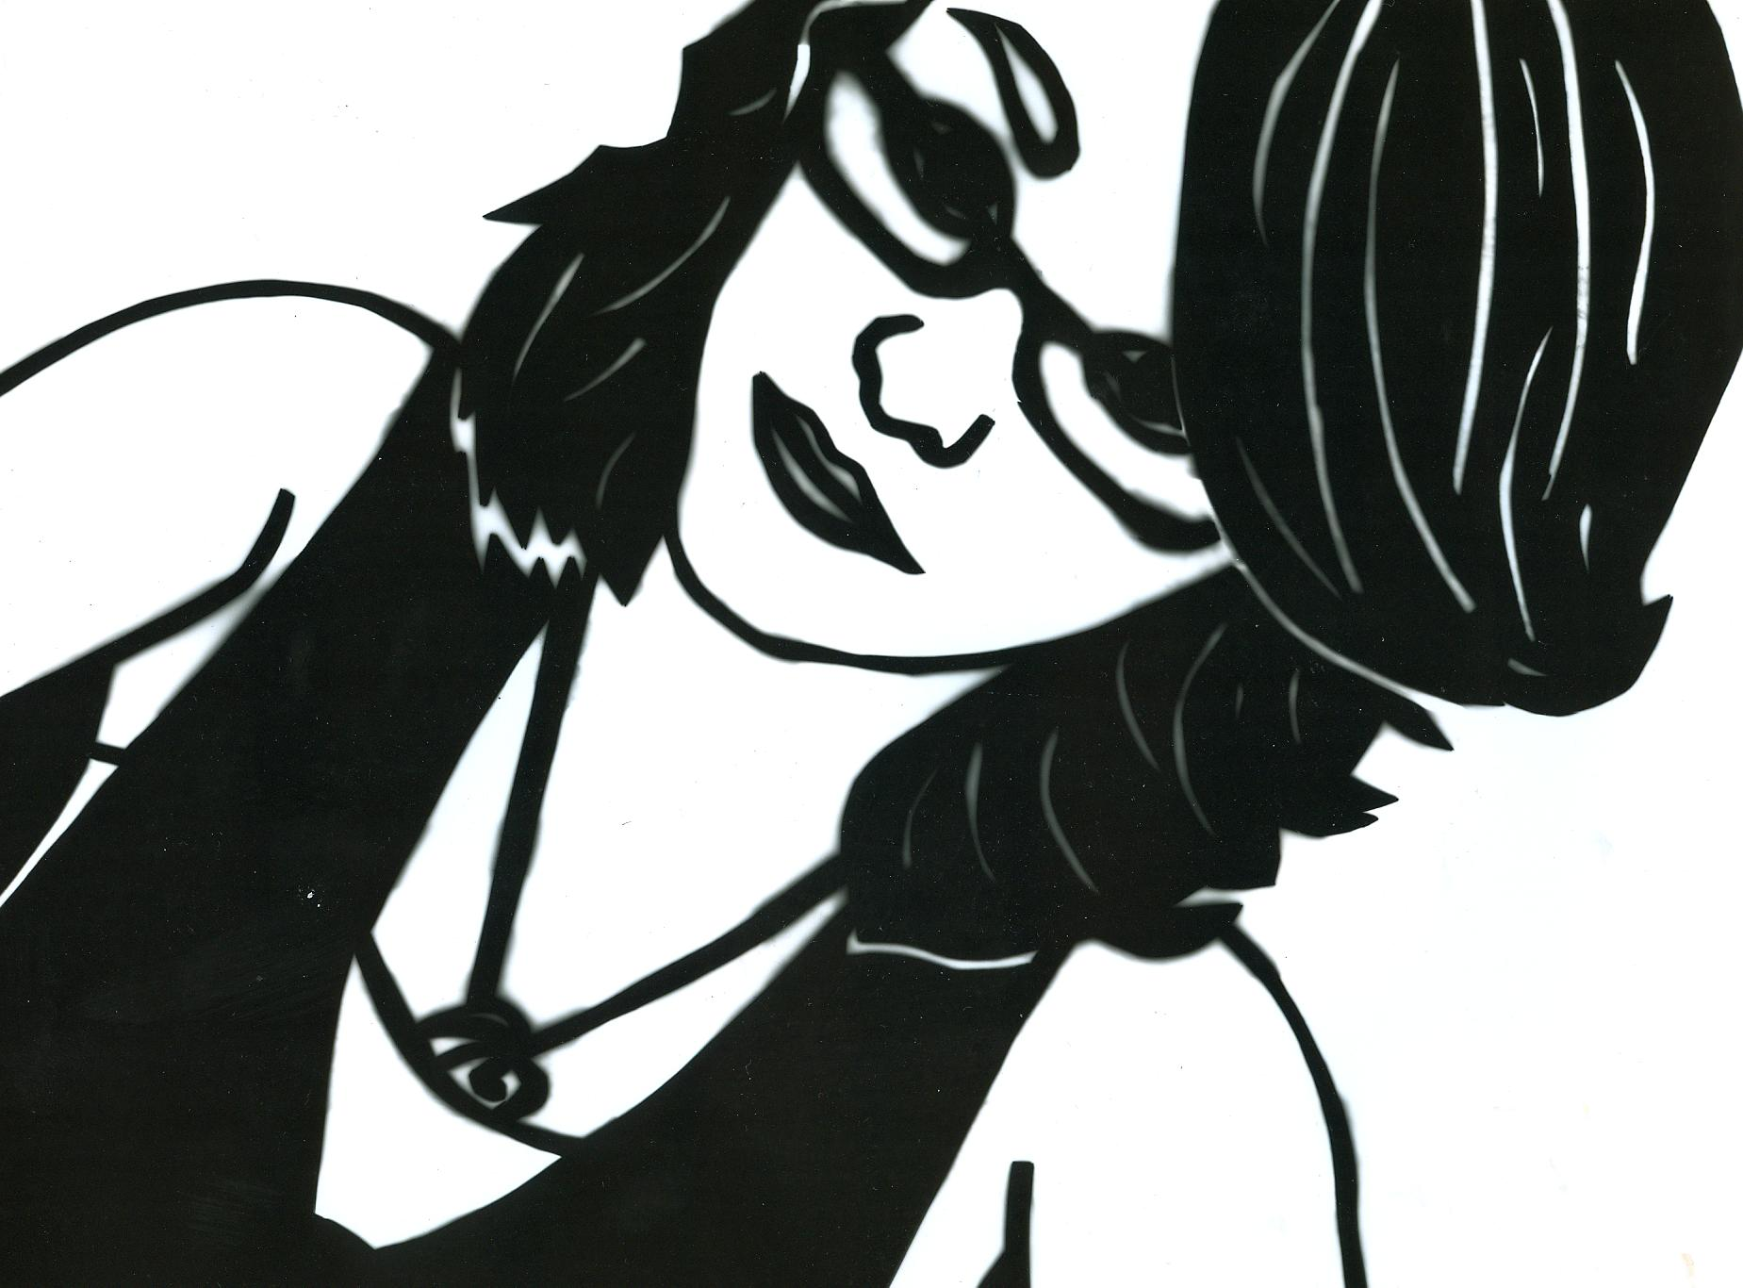

Slide 28
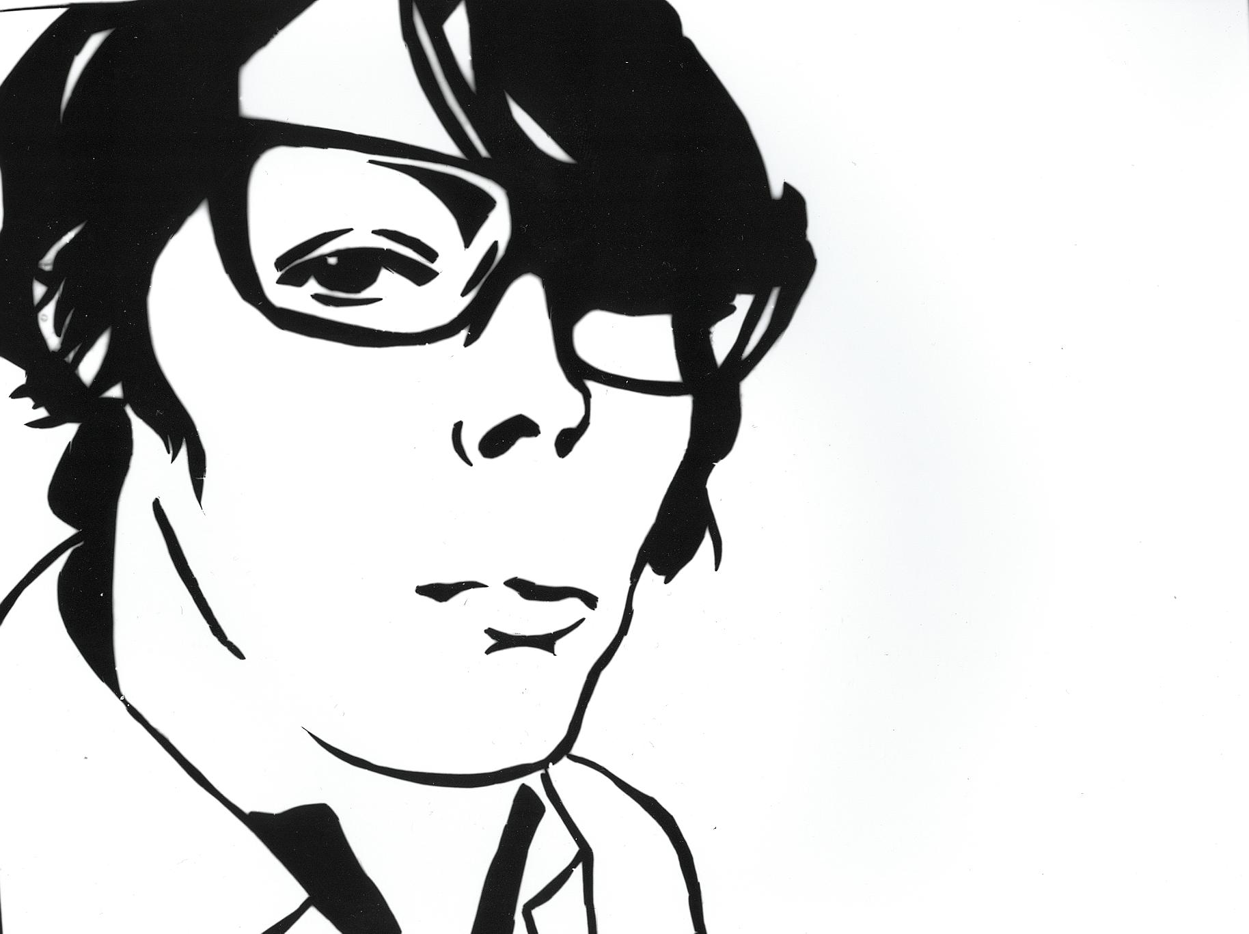

Slide 29
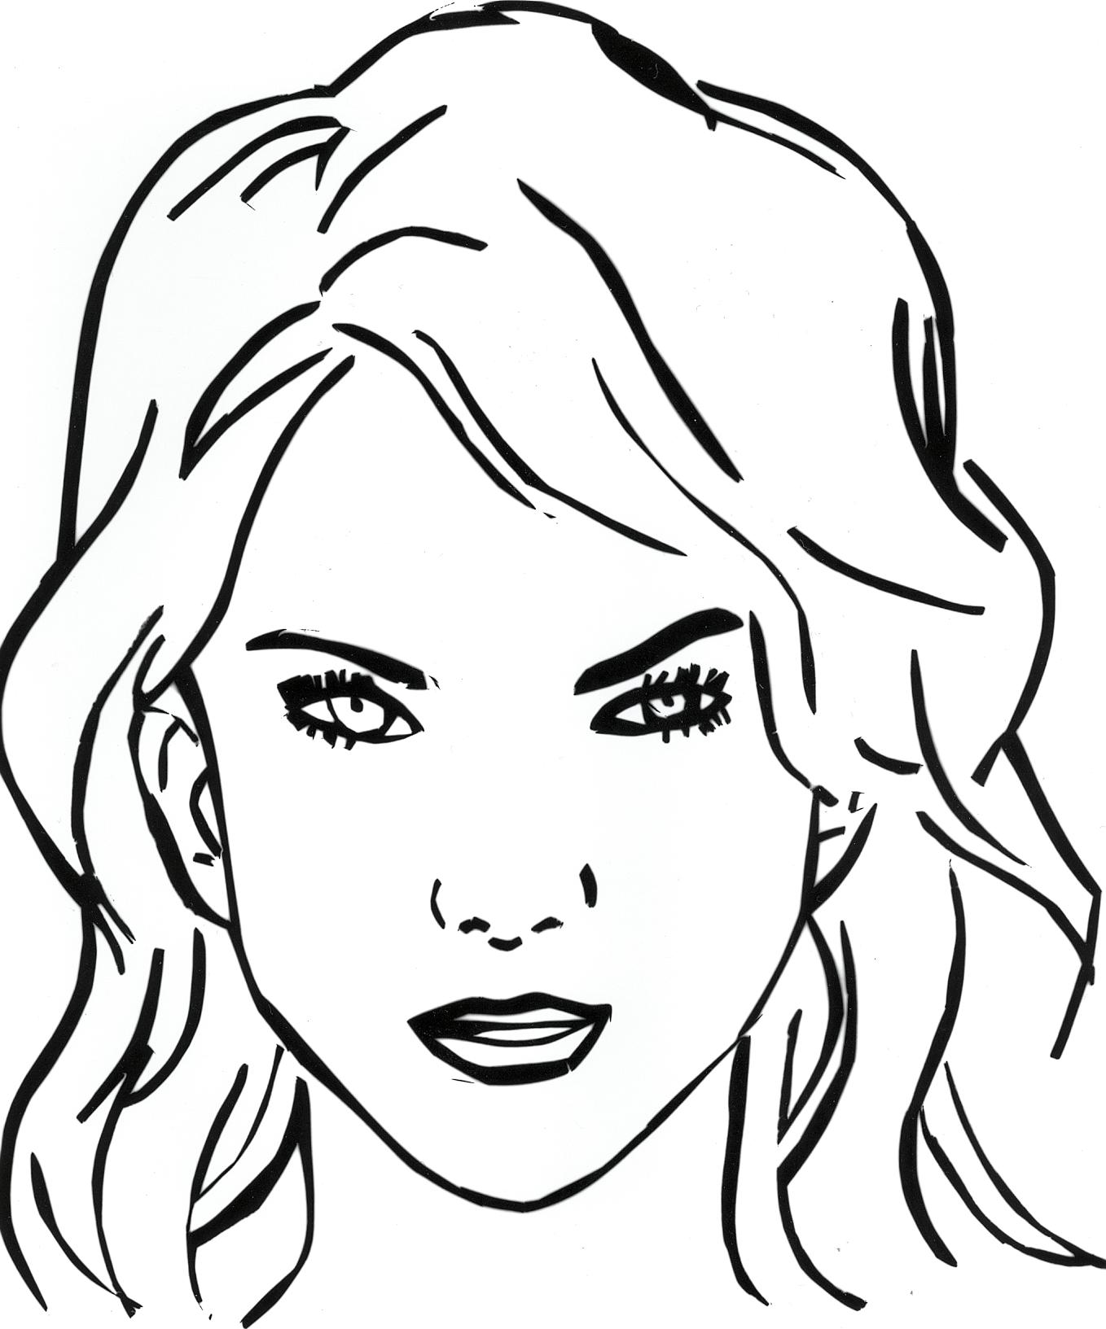

Slide 30
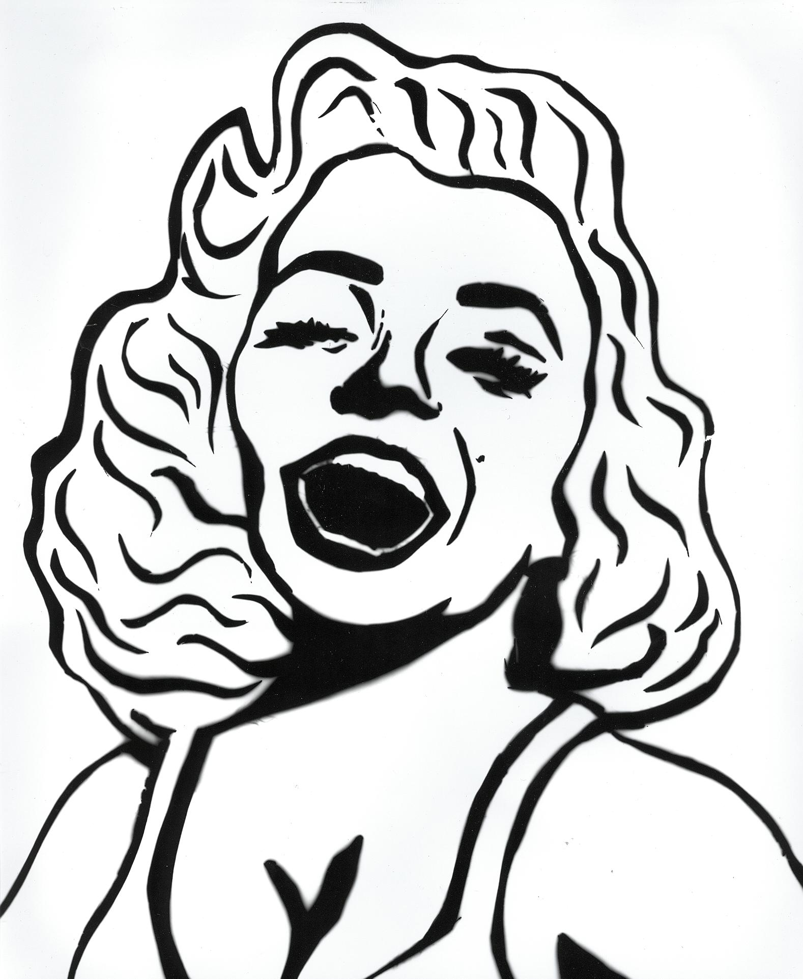

Slide 31
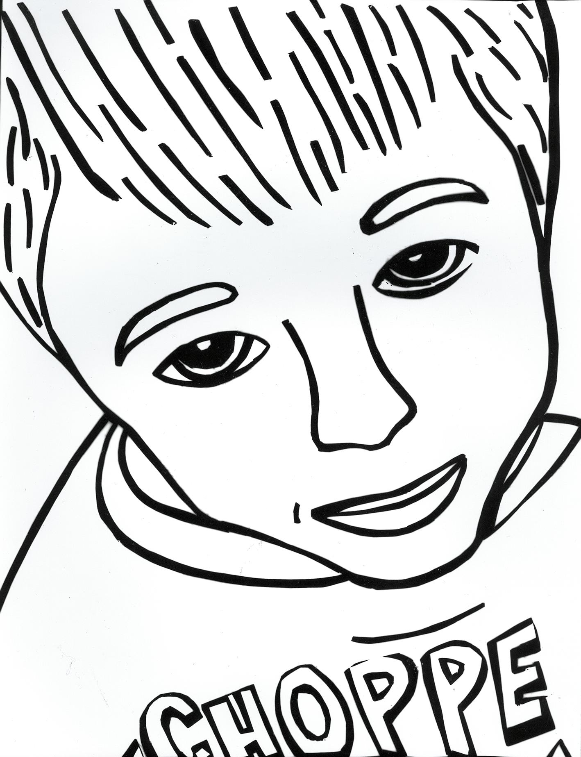

Slide 32
