Slide 1
Pinhole Camera
The

Slide 2
What is a pinhole camera?
A pinhole camera is a simple camera without a lens and with a single small aperture, a pinhole – effectively a light-proof box with a small hole in one side.
Light from a scene passes through this single point and projects an inverted image on the opposite side of the box.

Slide 3
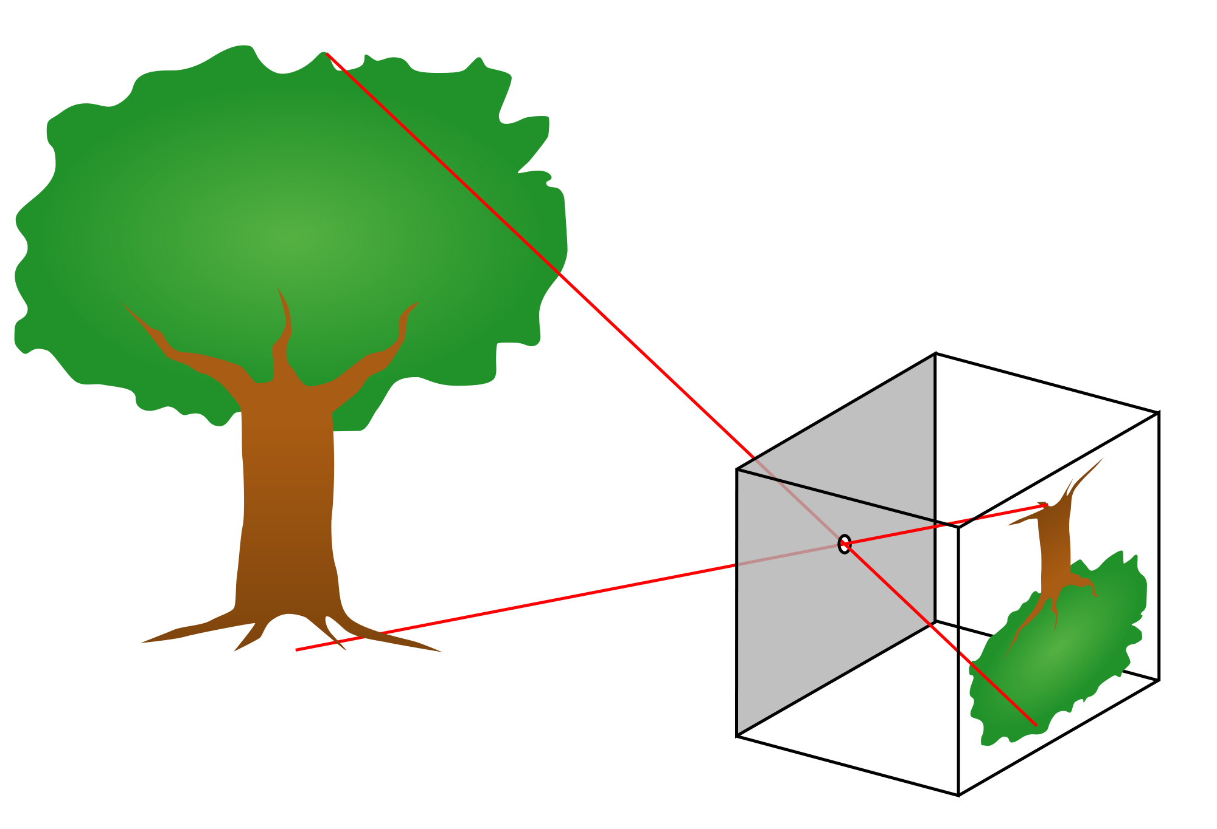
Pinhole cameras flip the image in the camera, just like the Camera Obscura

Slide 4
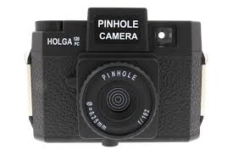
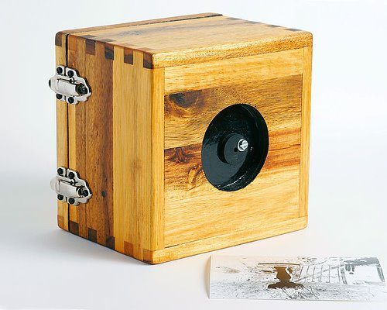
Pinhole cameras can be made from most anything!

Slide 5
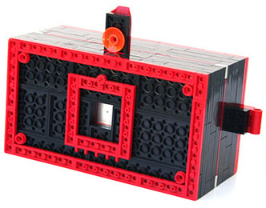
Pinhole cameras can be made from most anything!

Slide 6
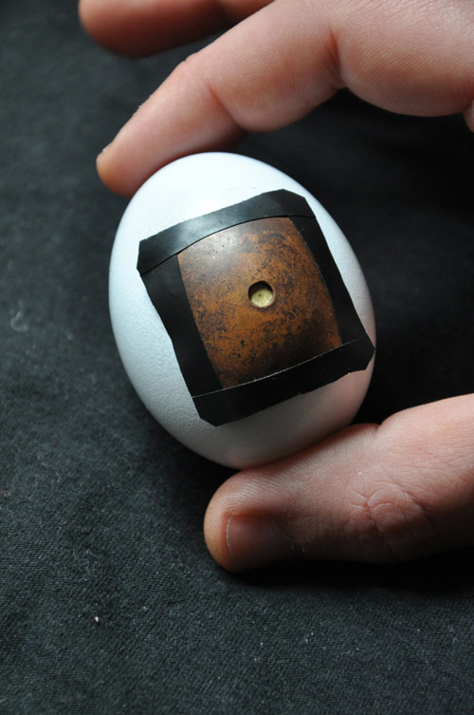
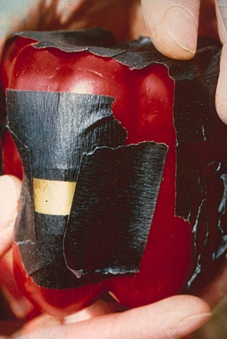
Pinhole cameras can be made from most anything!

Slide 7
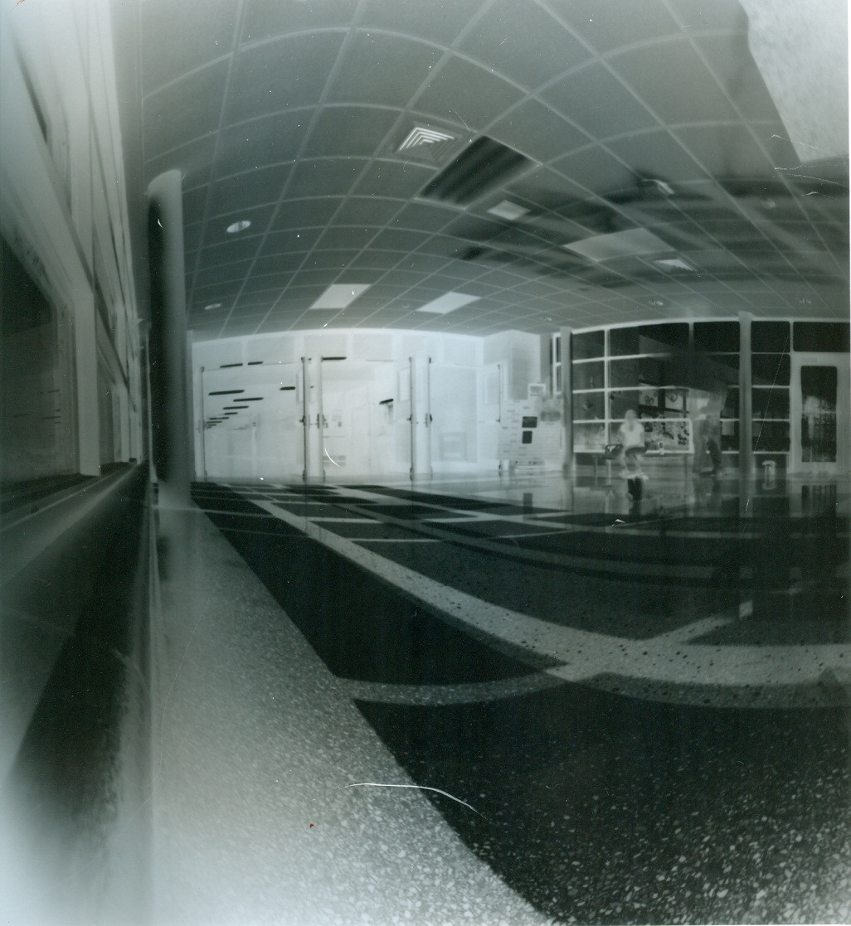
Pinhole cameras make unique images!
A negative image is projected on the light sensitive material that is put in the camera.

Slide 8
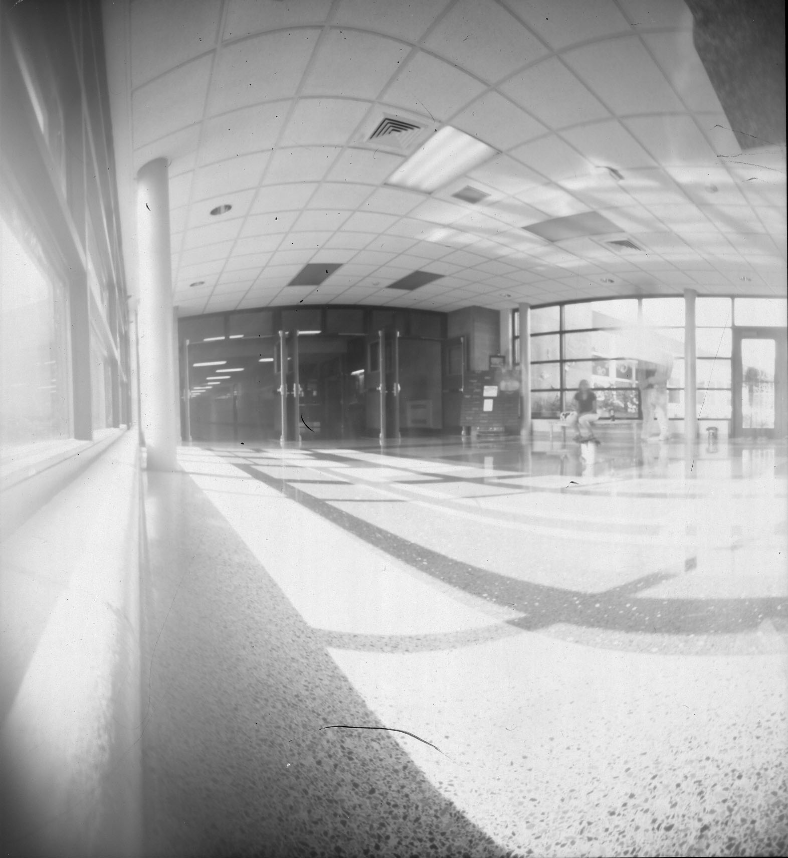
Pinhole cameras make unique images!
When you invert the image, you get the correct values!

Slide 9
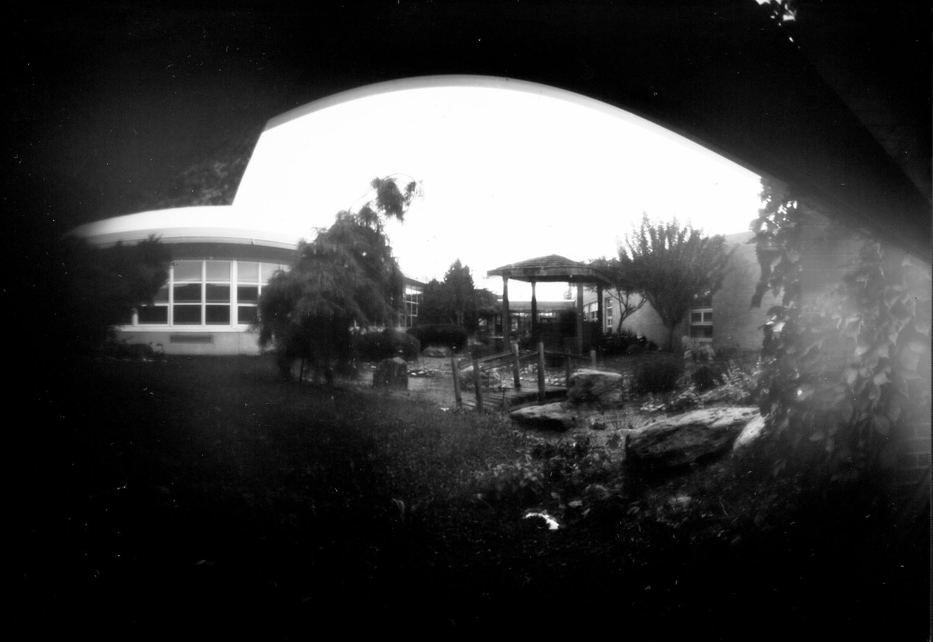
Pinhole cameras make unique images!

Slide 10
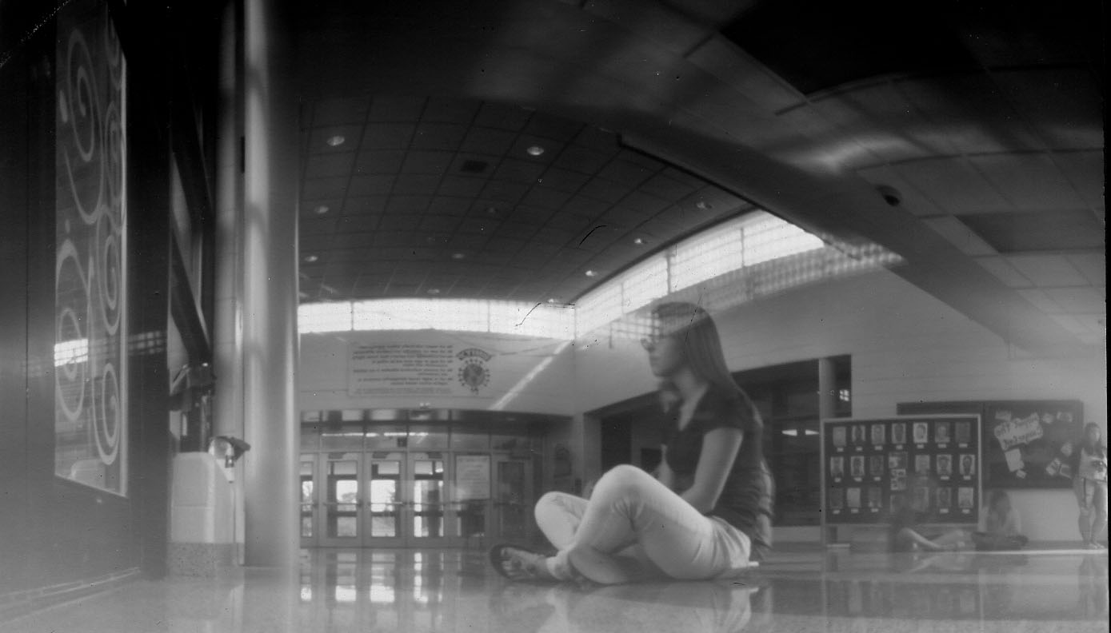
Pinhole cameras make unique images!

Slide 11
Making a Pinhole Camera
The Process of

Slide 12
Steps:
Choose container
Paint inside of container black
Paint inside and outside of container’s lid black
Tape black paper to inside of lid
Cut a one inch square opening in the center of the container
Puncture a pinhole in a piece of copper
Tape copper over square hole with black tape
Inspect container for any light leaks, and cover with either black tape or paper

Slide 13
Today we will…
Choose container
Paint inside of container black
Paint inside and outside of container’s lid black

