Slide 1
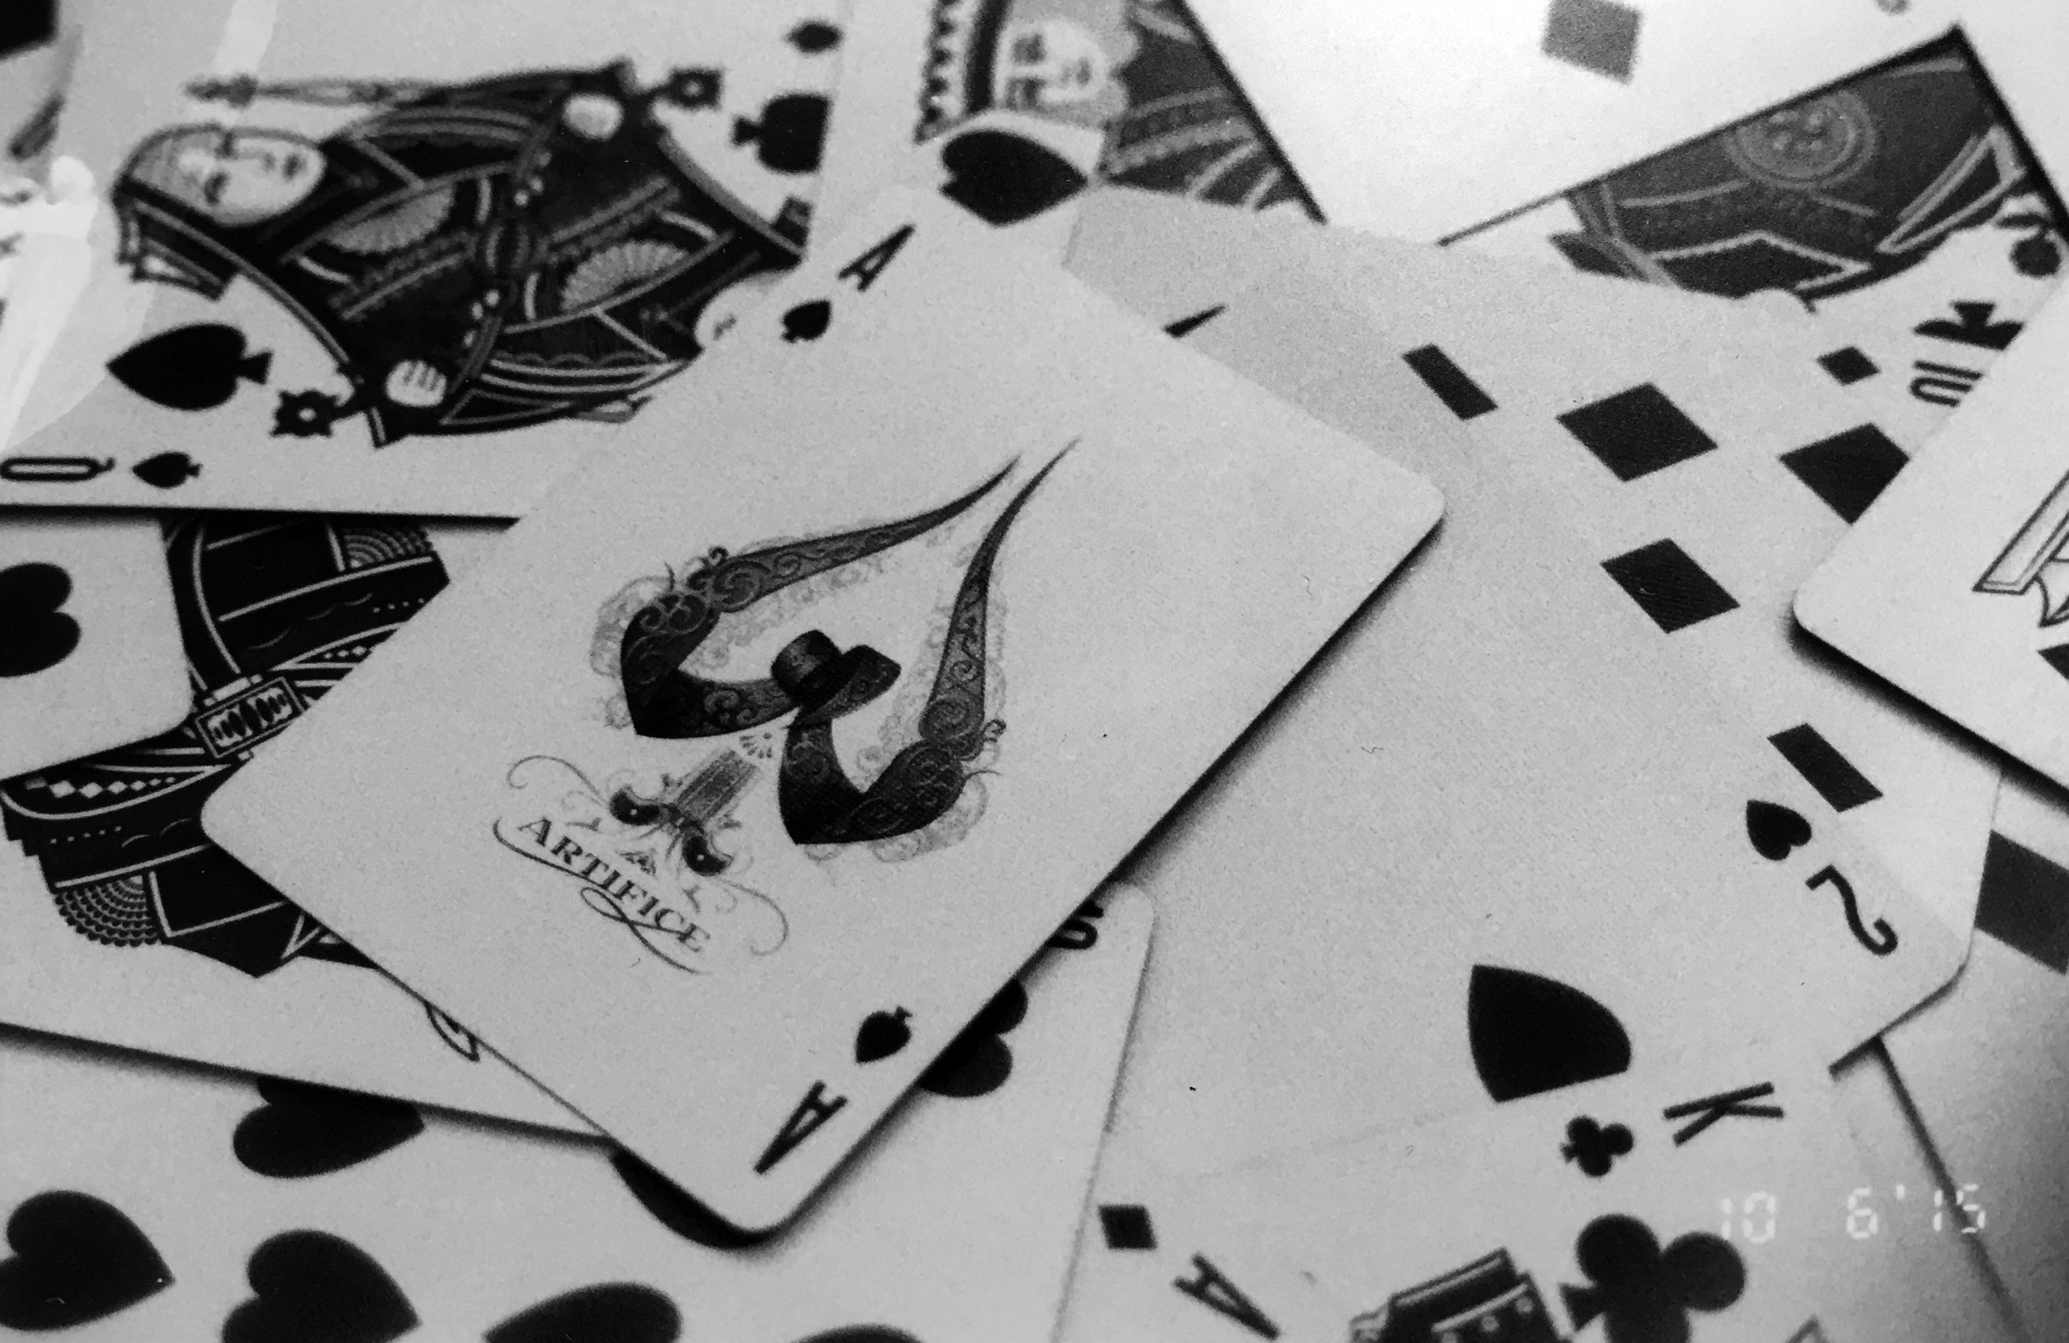
Composition Combinations
Photography

Slide 2
Instructions:
Start by matching each subject matter with a compositional element. You will then combine those two parts into a photograph. You will choose 5 different combinations from the provided list.
For each of those 5 combinations, you will take 4 photographs that best represent that combination choice.

Slide 3
Example:
If I chose breakfast as my subject matter and texture as my compositional element I could focus on the crispy texture of my cereal in comparison to the smooth milk surrounding it.
Then, I will look at different viewpoints that may also be a good photograph and continue to take 3 more photographs of that combination.

Slide 4
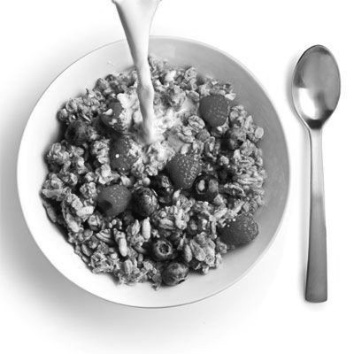
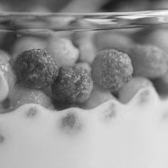
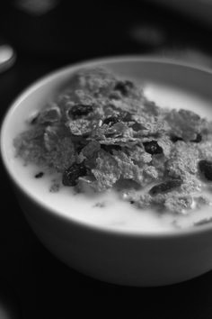
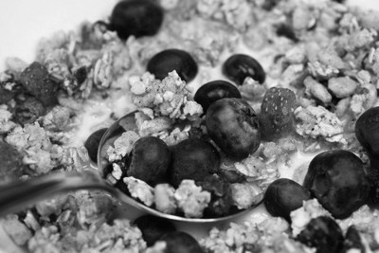
Example: Daily Routine/Texture

Slide 5
Composition Elements
Poor Depth of Field
Rule of Thirds
Lines
Symmetrical Balance
Framing
Focal Point
Emotion
Repetition
Texture
High/Low Position
Subject Matter
Happiness
Opposites
Laughter
Technology
Breakfast
Hands
Landscape
Something Old
Inside your fridge
Daily Routine

Slide 6
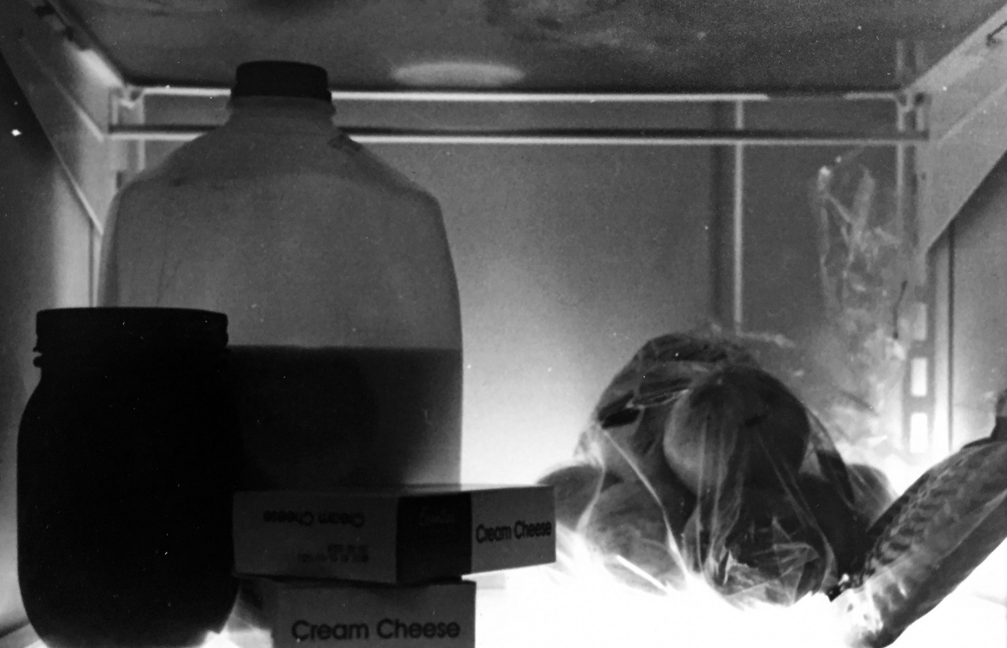
Inside your fridge/Poor depth of field

Slide 7
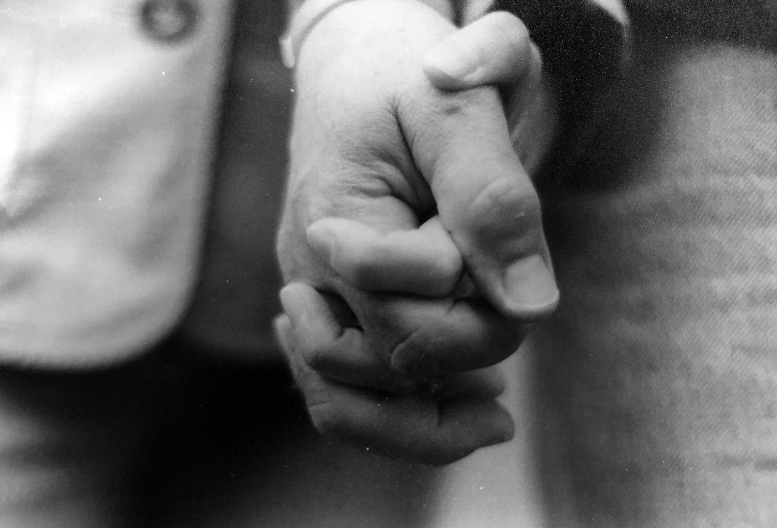
Hands/Symmetrical Balance

Slide 8
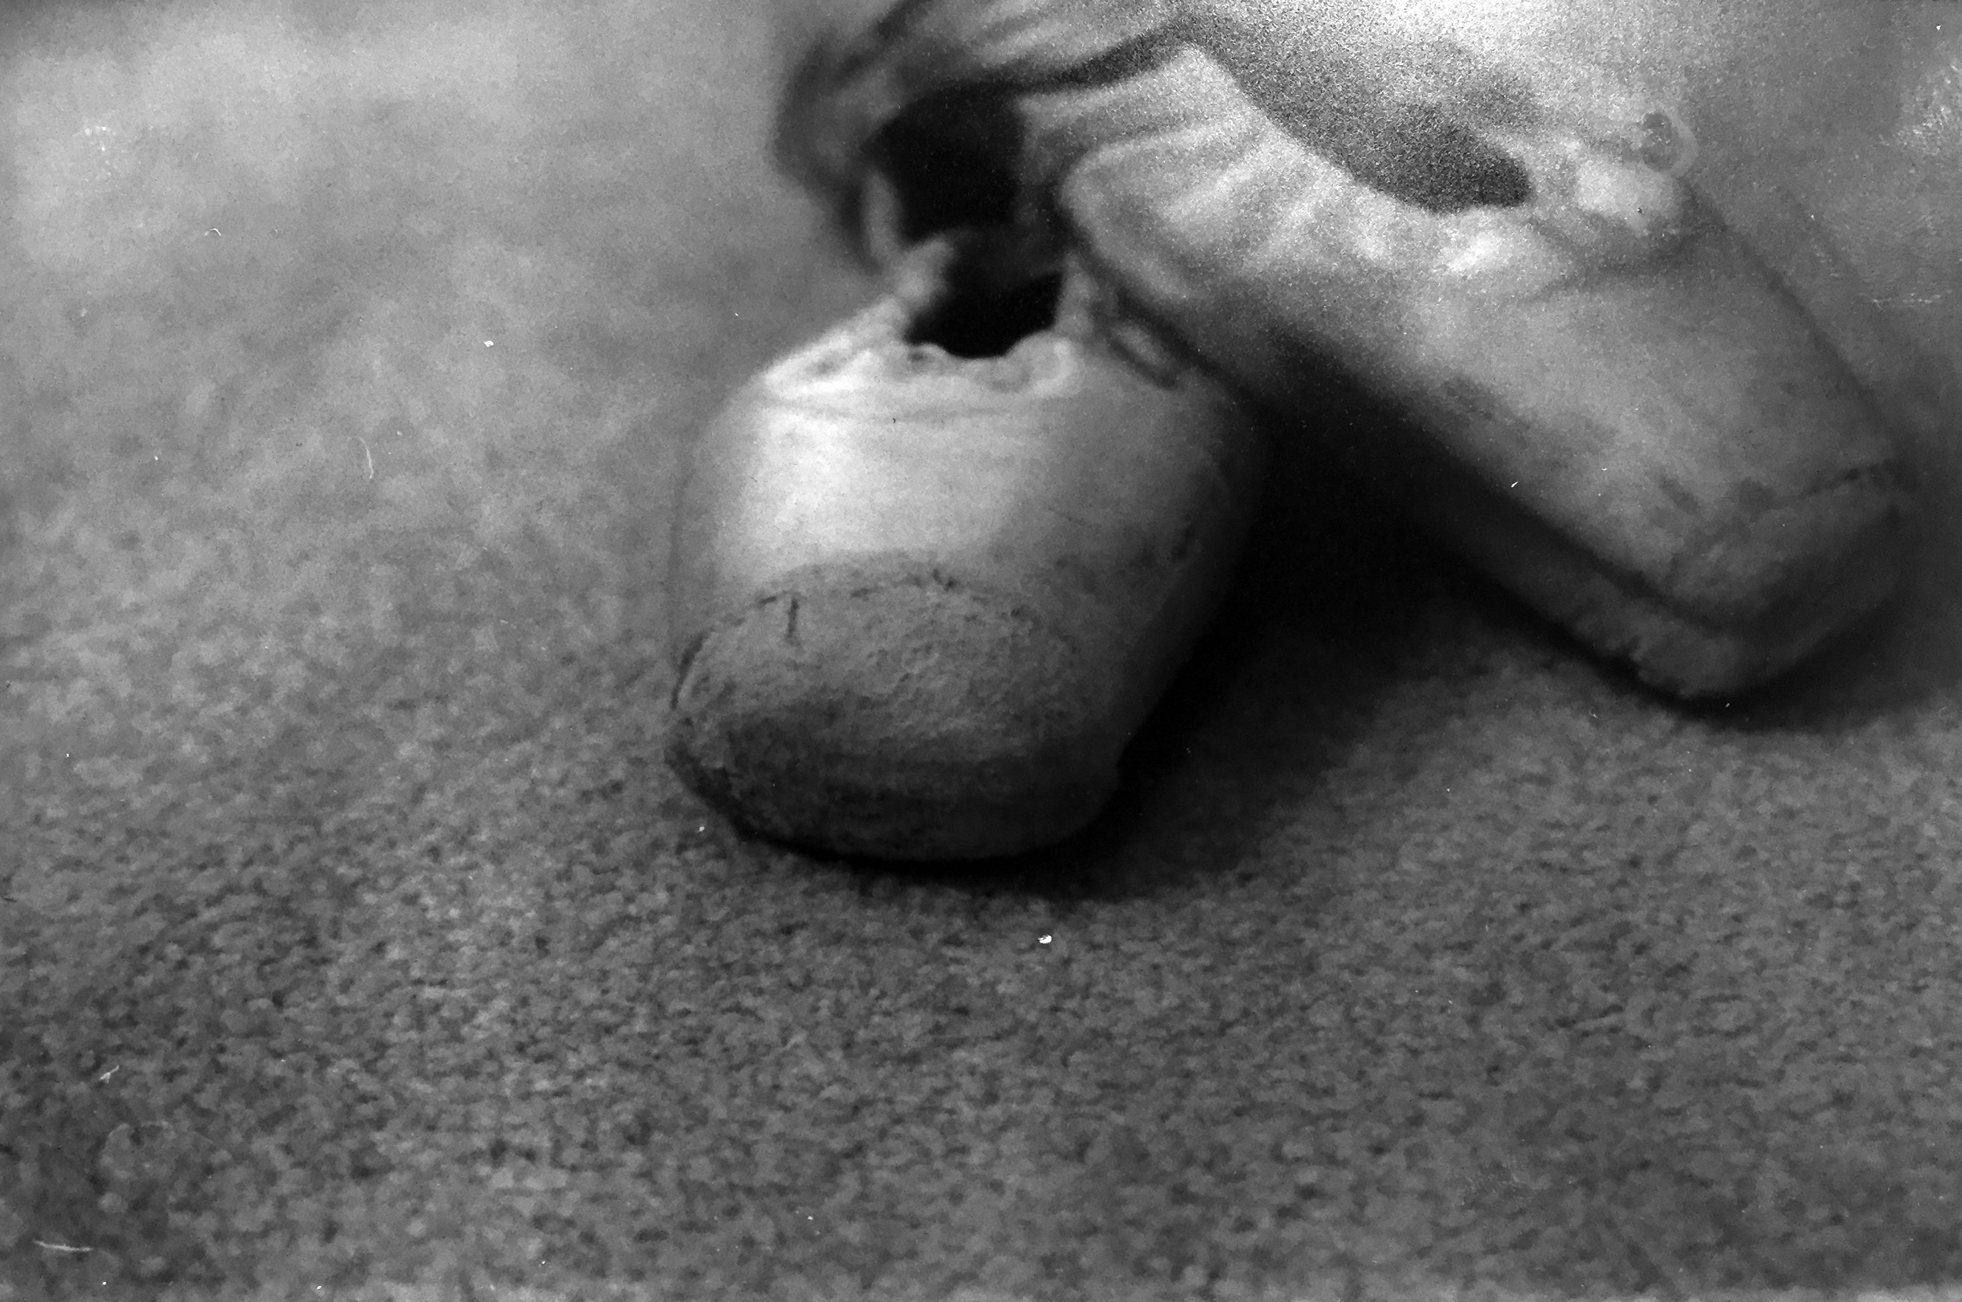
Something Old/Rule of Thirds

Slide 9
Daily Routine/Focal Point

