Slide 1
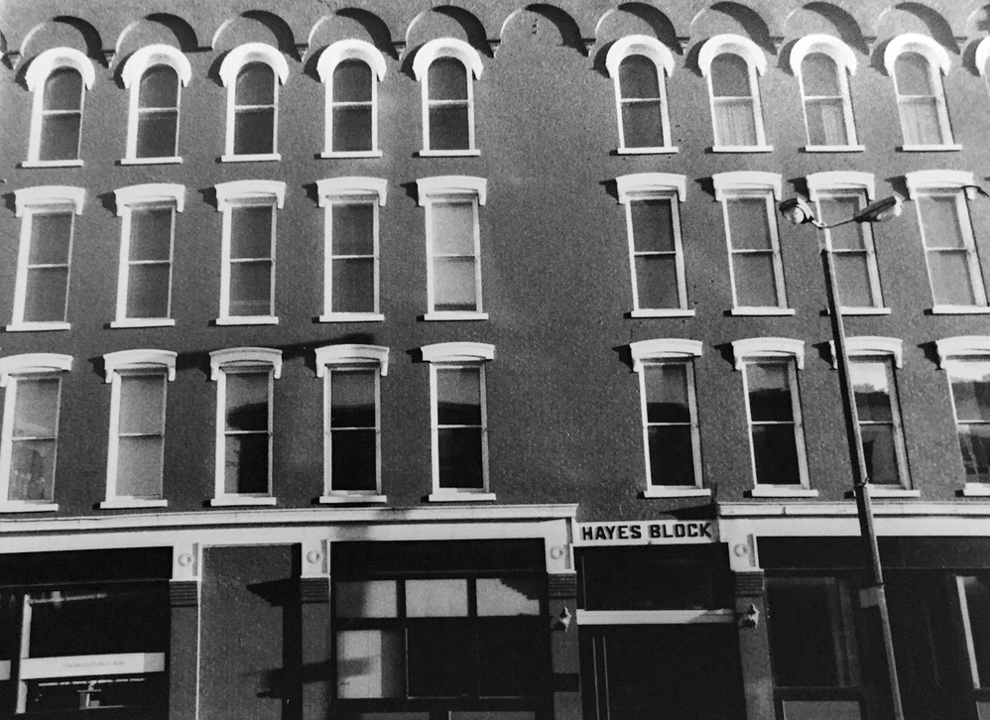
Architecture
Photography

Slide 2
Downtown Janesville – 12 photos
Look carefully and observe the intricate adornments of the many historic buildings Janesville has to offer.
You may choose to concentrate on a single architectural element or shoot the building from many different angles and vantage points.
Look for interesting and unique ways to showcase the architecture of downtown Janesville.
At least 6 photos should be close ups of the details of buildings.

Slide 3
Your Home– 12 photos
This is your opportunity to make your dwelling stand out.
You may live in a “boring old apartment” or a plain house, but I want to challenge you to find interesting details to photograph.
At least 6 photos should be close ups of the details of your home.
Think of patterns in brick or siding, interesting fencing or railings, etc.

Slide 4
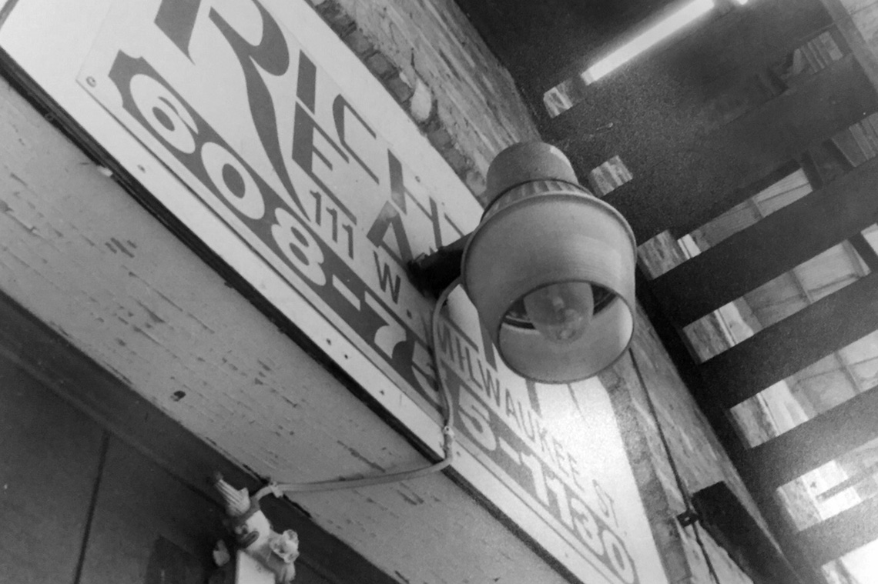

Slide 5
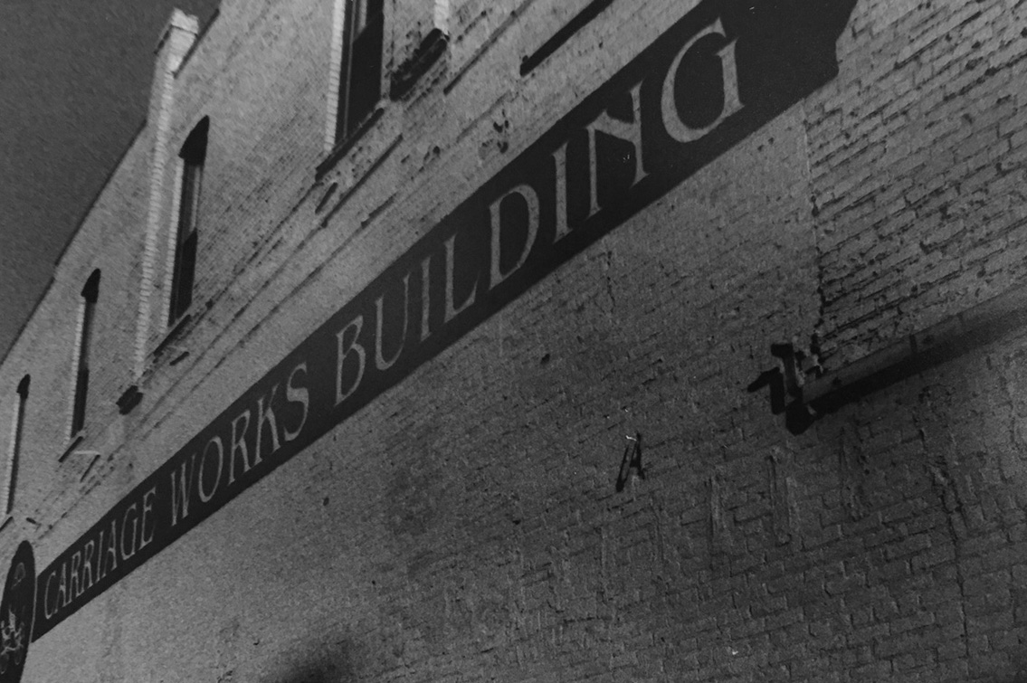

Slide 6
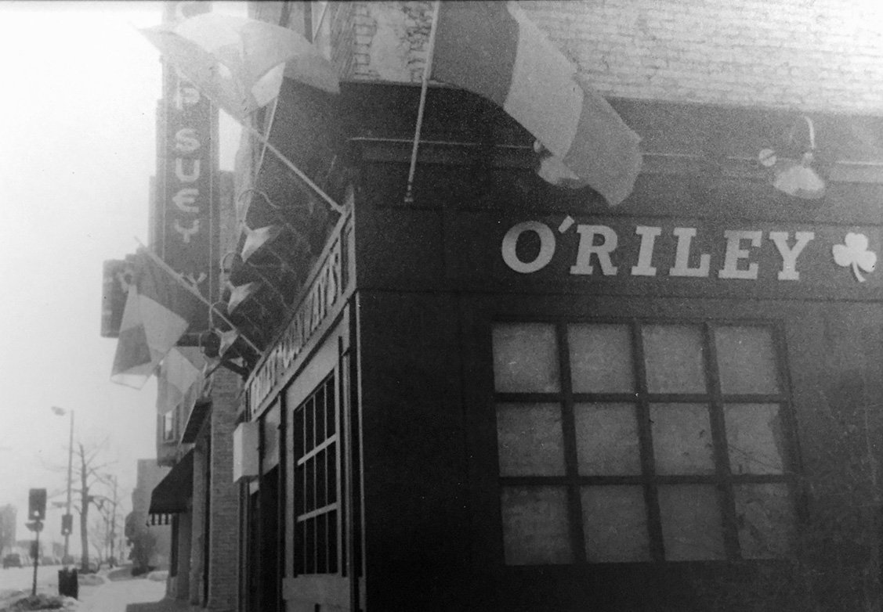

Slide 7
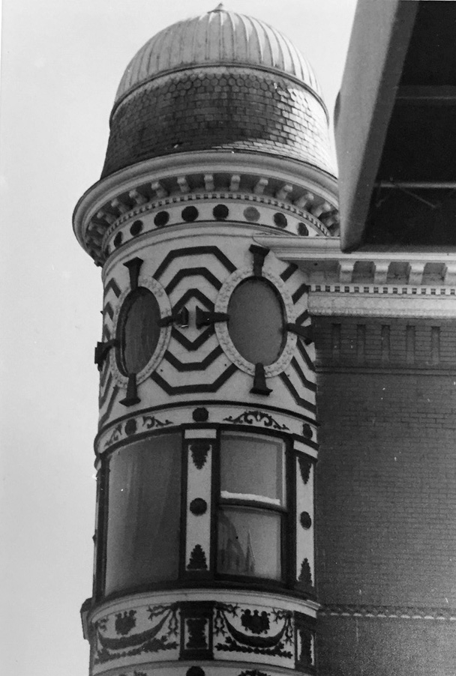
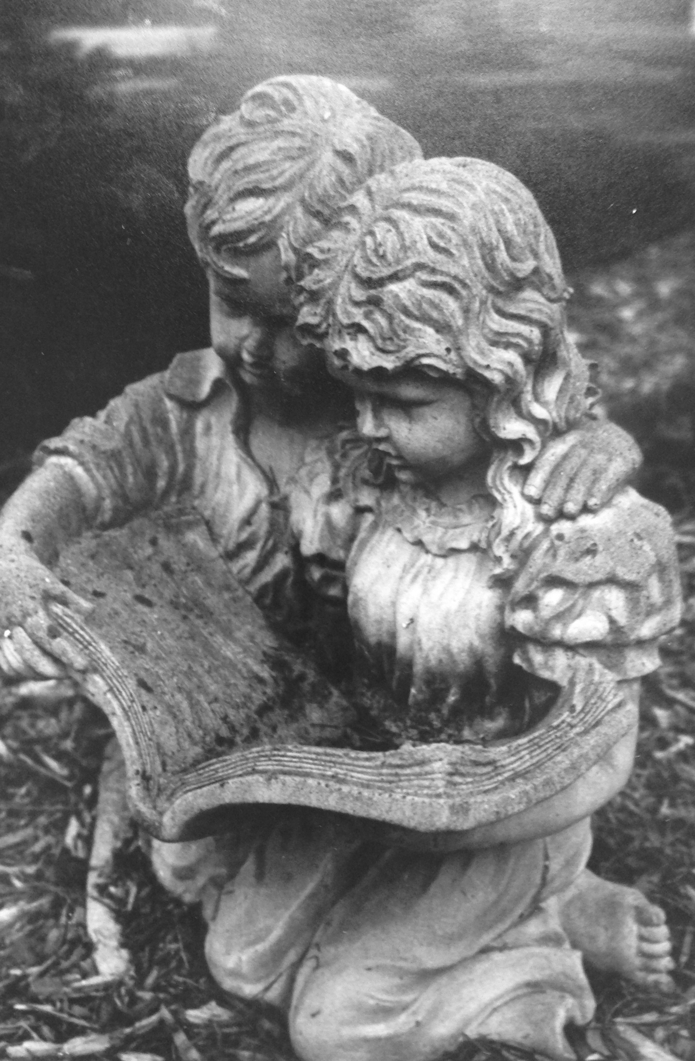

Slide 8
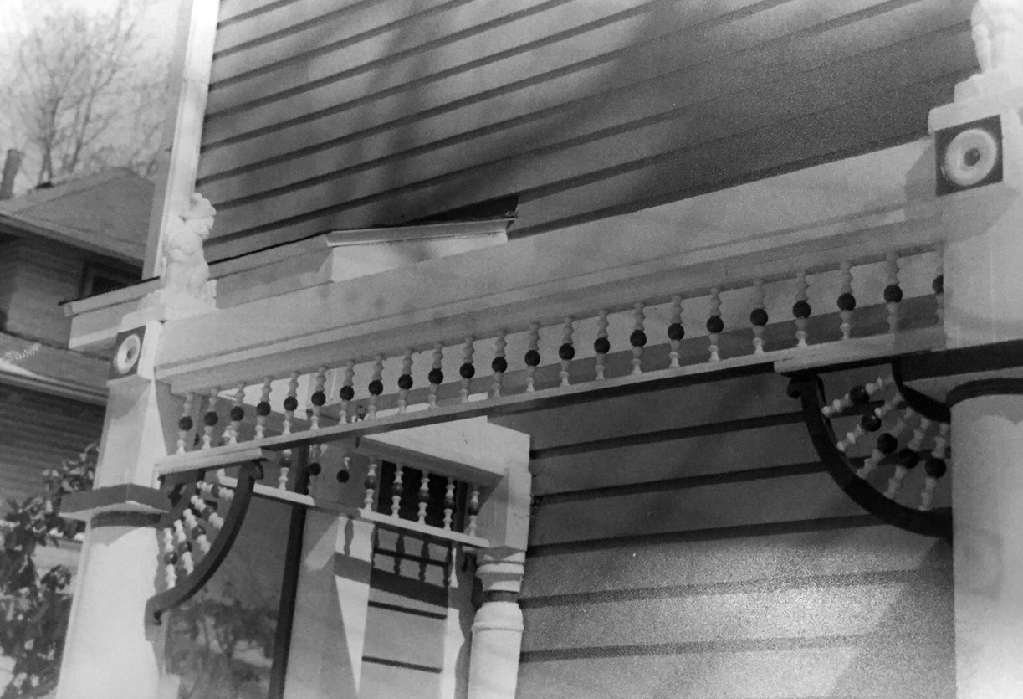

Slide 9
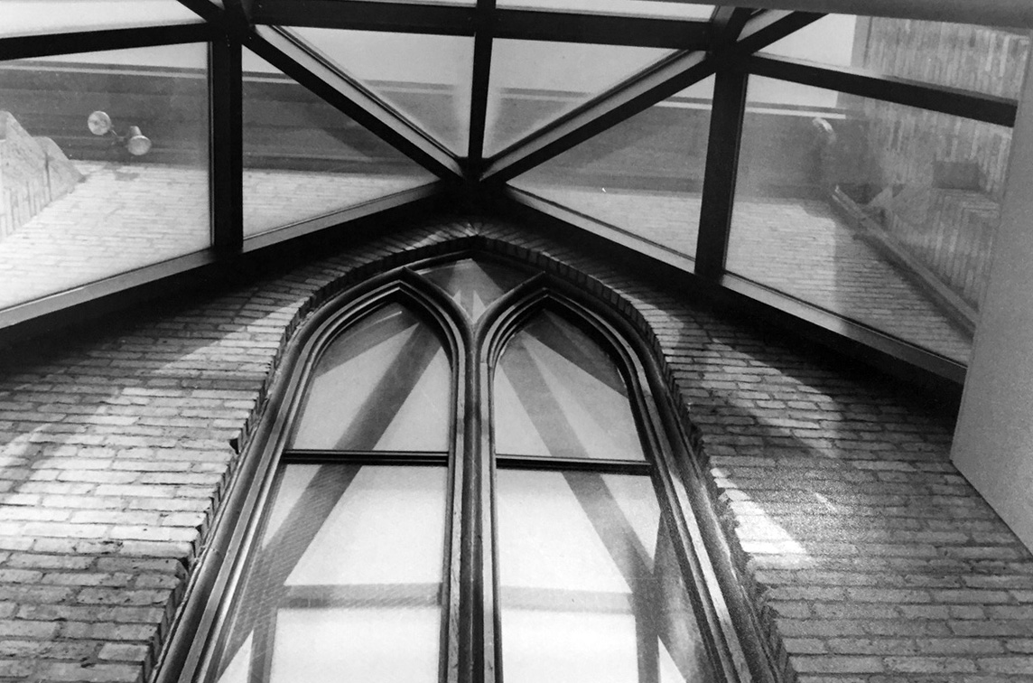

Slide 10
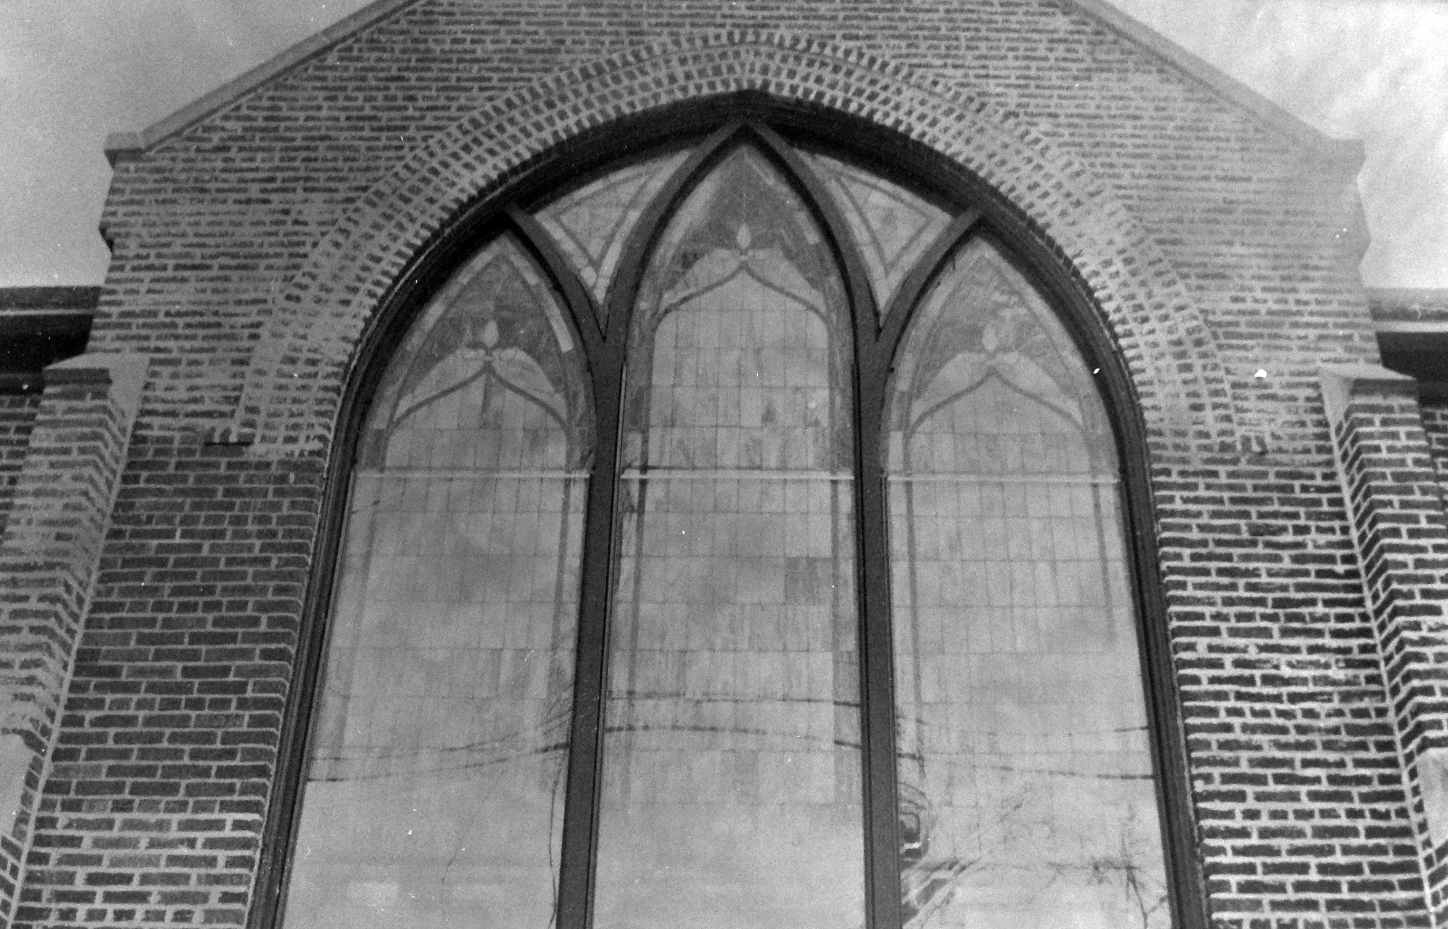

Slide 11
