Slide 1
Pewter Casting
Art I – Metals Unit

Slide 2
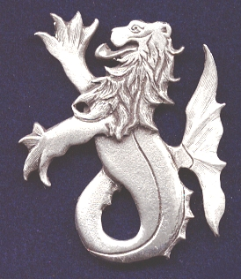
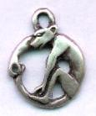
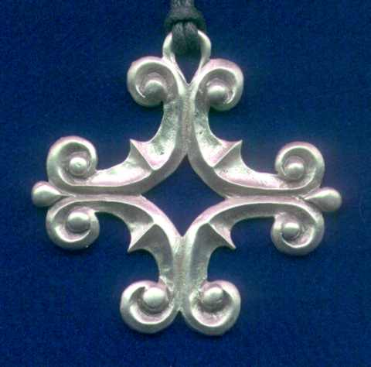
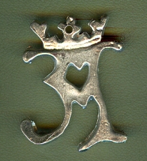
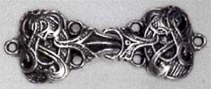
Pewter Casting
Pewter casting is a Medieval art form
Designs often consisted of animals
Pewter is an alloy of tin and a little copper
Pewter has a low melting temperature of 500-750 degrees

Slide 3
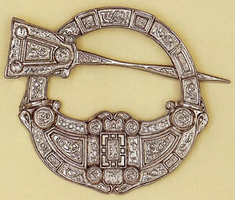
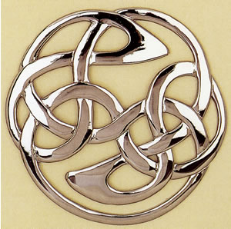
Pewter Silver
Pewter does not have a glossy finish. It has more of a satin finish.

Slide 4
The Project
What will you need to accomplish?

Slide 5
Create a nature inspired pewter casting
Create a design based on images from nature
Remember that we will be casting your 2-dimensional drawing/design into a 3-dimensional piece by mold carving your design from plaster
Use the elements and principles of design to enhance your casting
Elements of Design:
Color
Line
Shape
Space
Texture
Form
Value
Principles of Design:
Balance
Emphasis
Rhythm
Repetition
Contrast
Movement
Unity

Slide 6
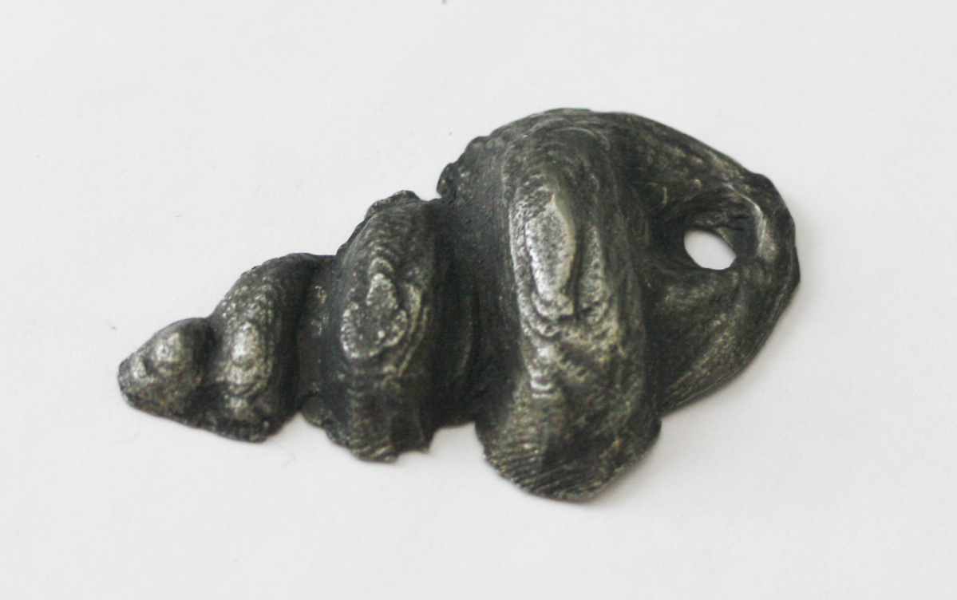
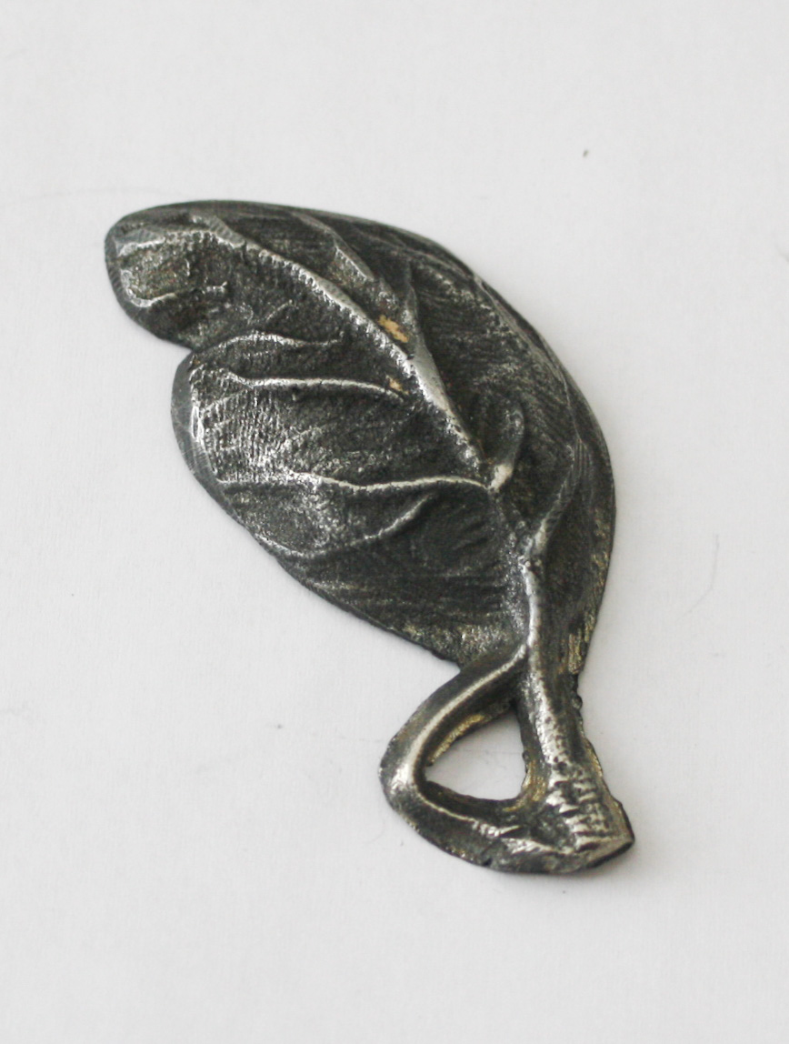
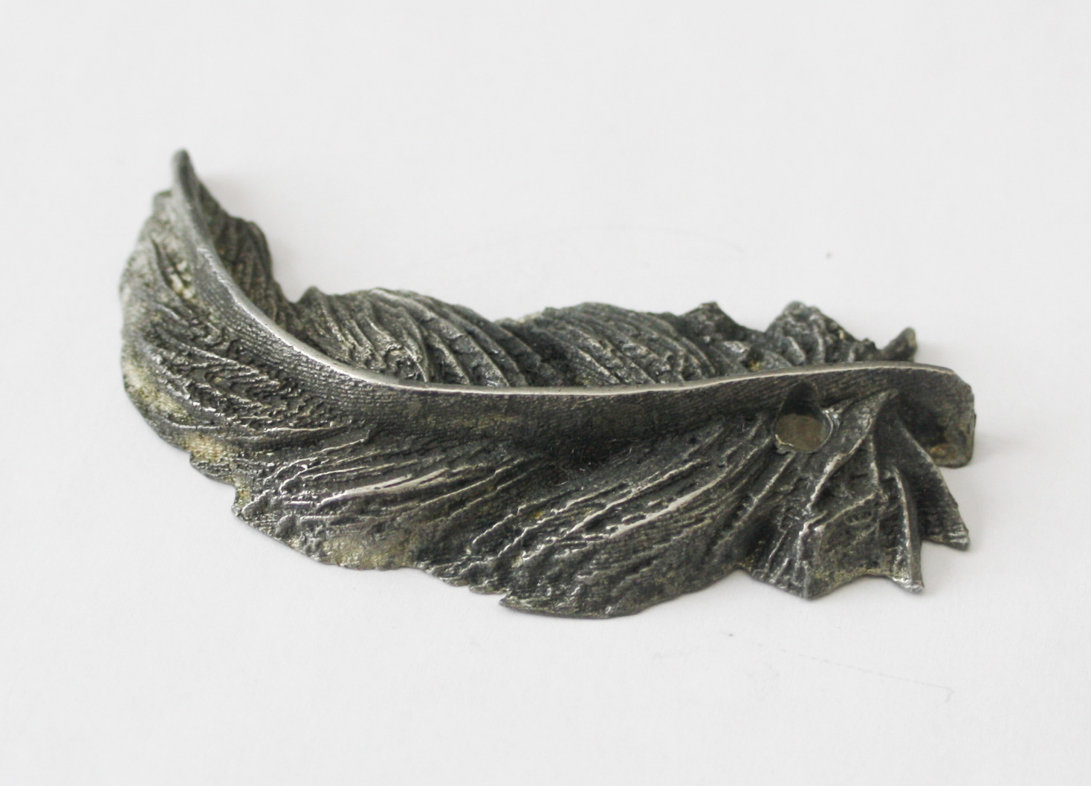
Student Examples Inspired by nature

